Slide 1
PROGRAMMING YOUR RADIOS WITH CHIRP
A Complete Beginners Guide To Using CHIRP Software
Presented by Dom Wilkinson, 2E0WHQ

Slide 2
What will this talk cover?
What is CHIRP, why do I need it and where do I find it?
What hardware do I need to use CHIRP?
Understanding Serial Ports, Software Drives and Dodgy Chinese Chips.
Getting it all connected and communicating with your radio.
The Basics, Reading, Saving, Editing and Rewriting radio configs.
Quick refresh on repeater operation; Frequencies, Shifts, CTCSS.
Putting it all together. DEMO.

Slide 3
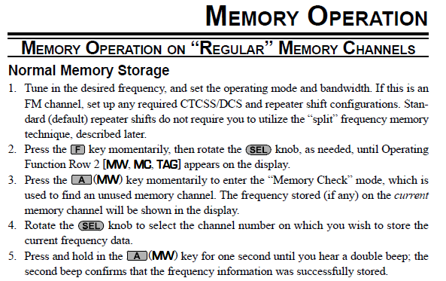
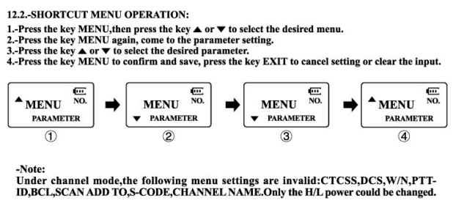
What is CHIRP, why do I need it and where do I find it ?
CHIRP is free, open-source, radio programming software, specifically developed for Amateur Radio. It is supported on Linux, Mac & Windows Operating Systems.
Programming radios can be confusing, time consuming and frustrating as there is no common mechanism. CHIRP aims to make this task easier.
Google “CHIRP” or go direct to https://chirp.danplanet.com/

Slide 4
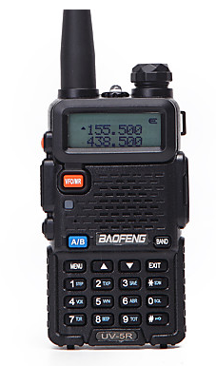
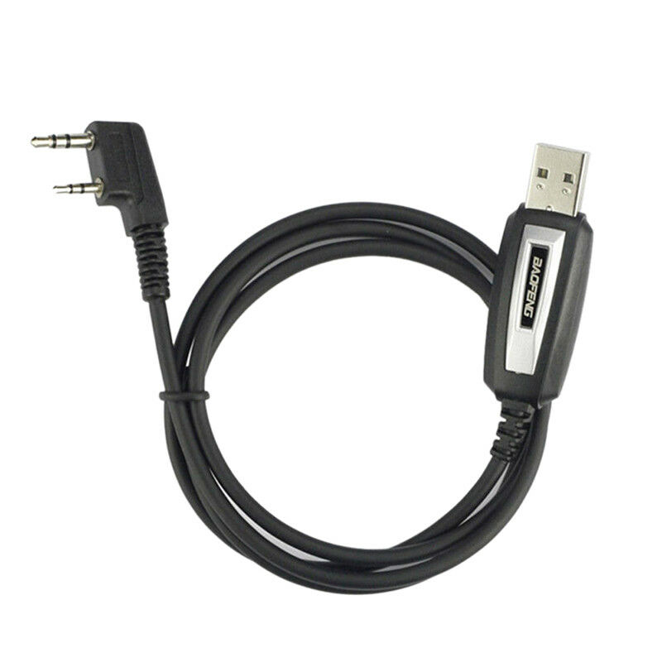
What hardware do I need to use CHIRP?
A radio which you are hoping to re-programme, a computer with a USB port or Serial Port for some really old radios and the necessary programming cable.
Check the CHIRP website for a complete list of compatible radios and makes sure that your radio can be programmed using CHIRP.
Programming cables can be bought from eBay for about £5 - £10 depending on which radio it is for. Note: Cheapest isn’t always best! Check the seller’s feedback and if possible purchase a genuine cable; It will save you a lot of pain!

Slide 5
Serial Ports, Software Drivers and Dodgy Chinese Chips
The key to success and less pain with CHIRP is to understand how USB ports handle Serial Port allocations, where to locate them in software and identify them and ensuring you have the correct software drivers.
Your programming cable has an inbuilt USB to RS232 Serial Port converter built in to it. When you plug it in to your computer it should be ‘plug & play’ and as long as you are connected to the Internet it should download the correct Software Drivers.
Prolific & FTDI are the most common USB to RS232 converter chip manufactures and BOTH have reported widespread counterfeiting of their chip technology and BOTH have implemented additional software measures to disable fake chipsets in cloned hardware. If you are unfortunate enough to have purchased a lead with a counterfeit chipset, then be prepared for a bit of faffing about with software drivers to find one which will work.

Slide 6
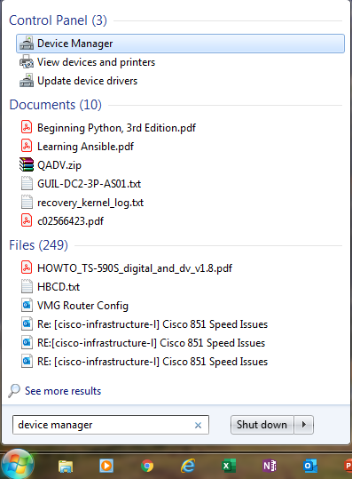
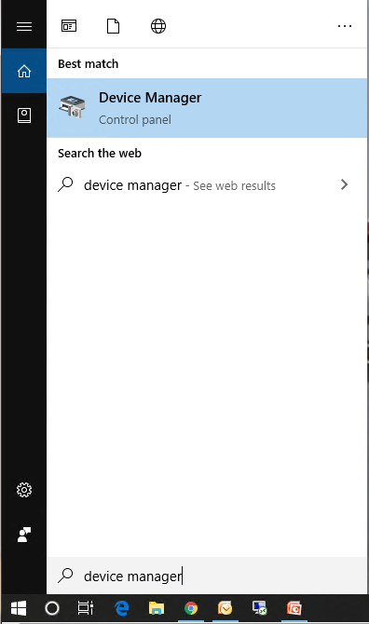
Where are my Serial Ports?
These instructions are for Windows 7 & Windows 10 as these are the most commonly used Operating Systems.
Before you plug anything in, locate and open Device Manager. The easiest way to do this is to use the Window Button ‘Search’ function’.

Slide 7
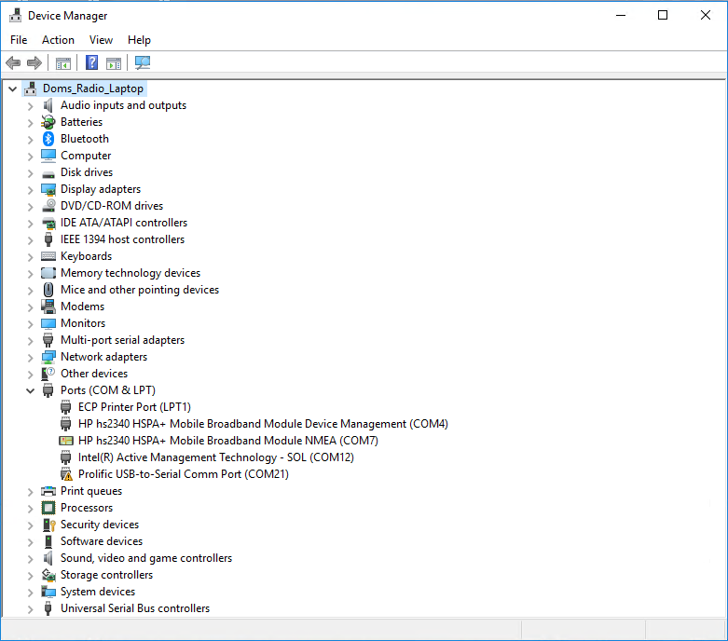
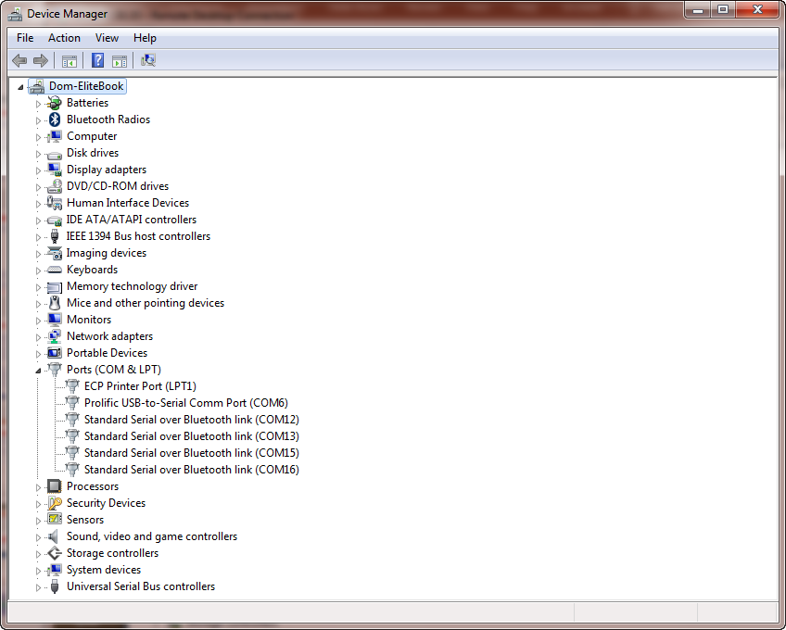
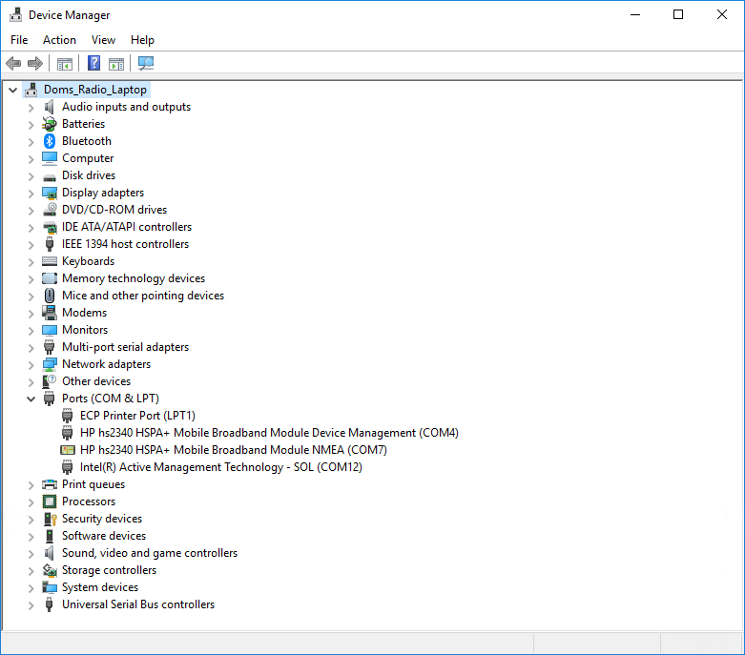
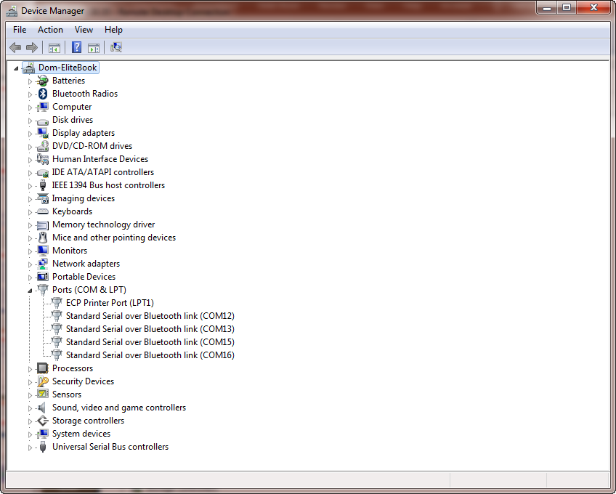
Where are my Serial Ports? …Continued…
Once you start Device Manager, locate your Ports:

Slide 8
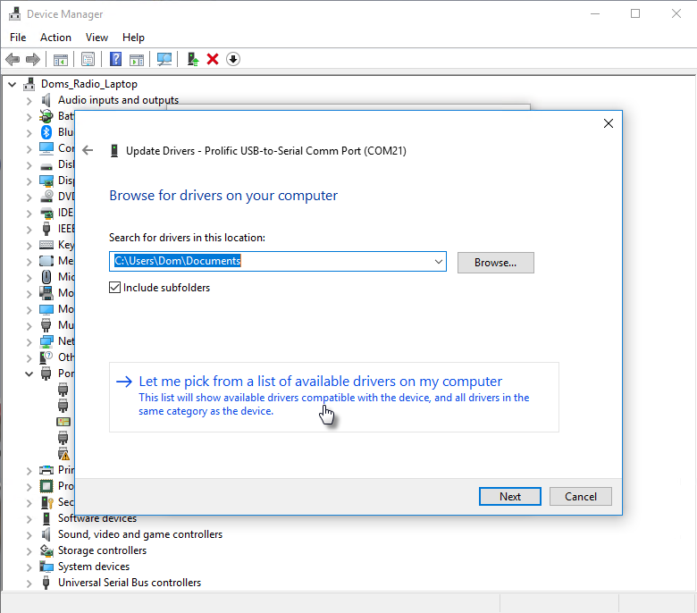
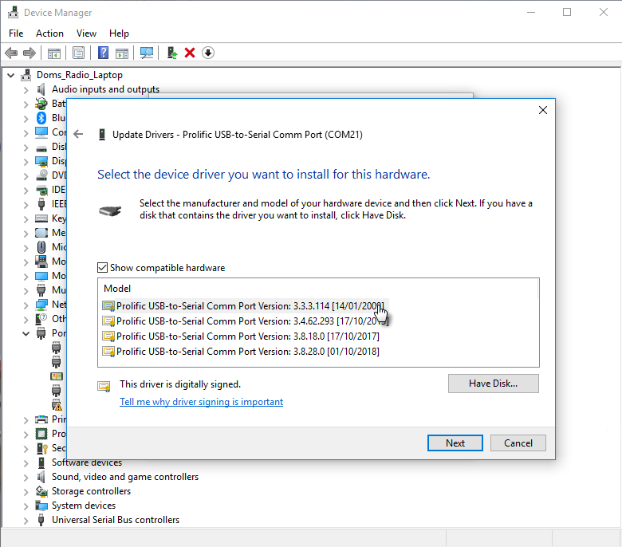
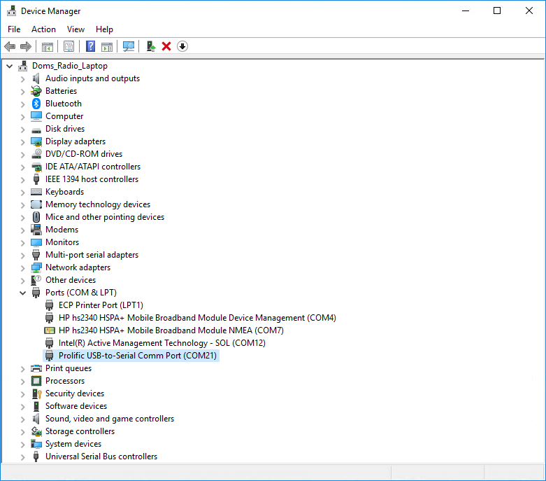
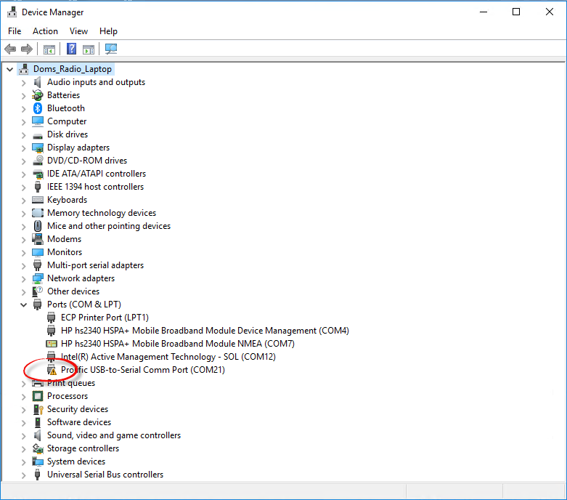
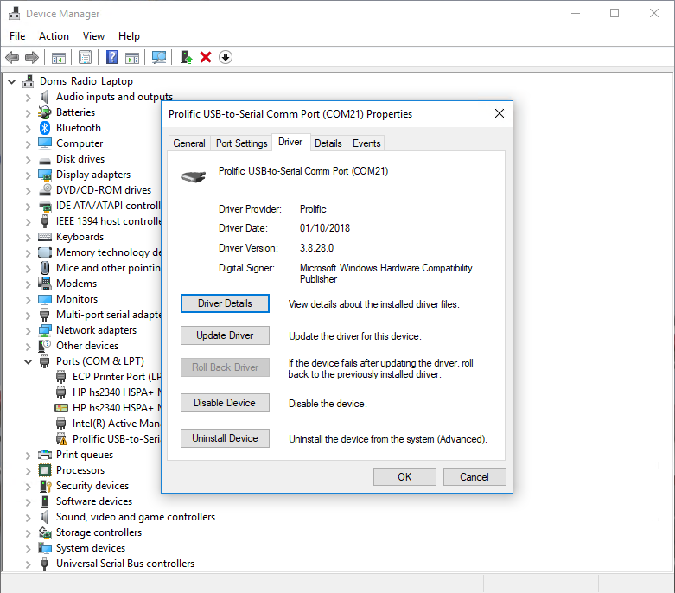
Sorting That Software Driver Issue
How to change the software device driver:

Slide 9
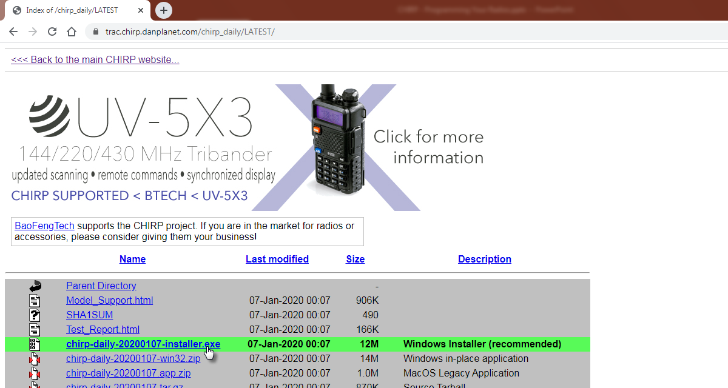
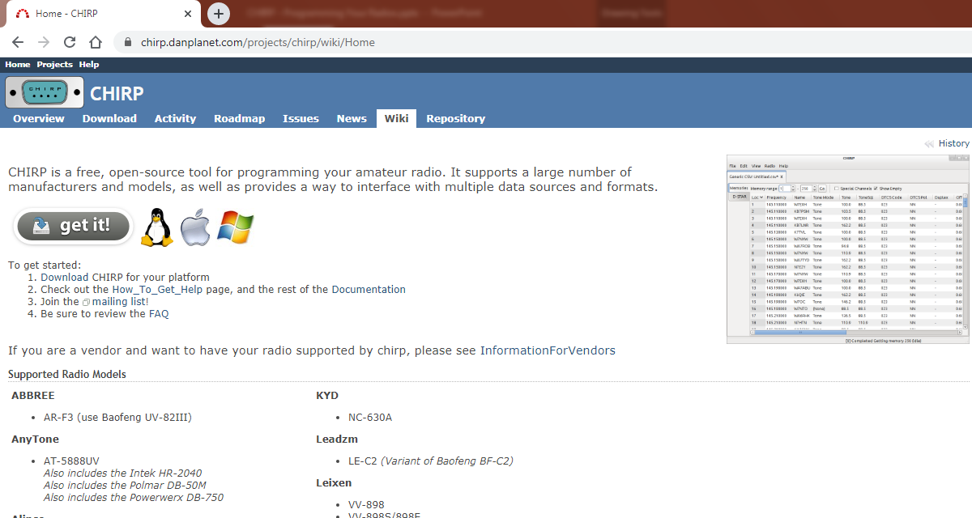
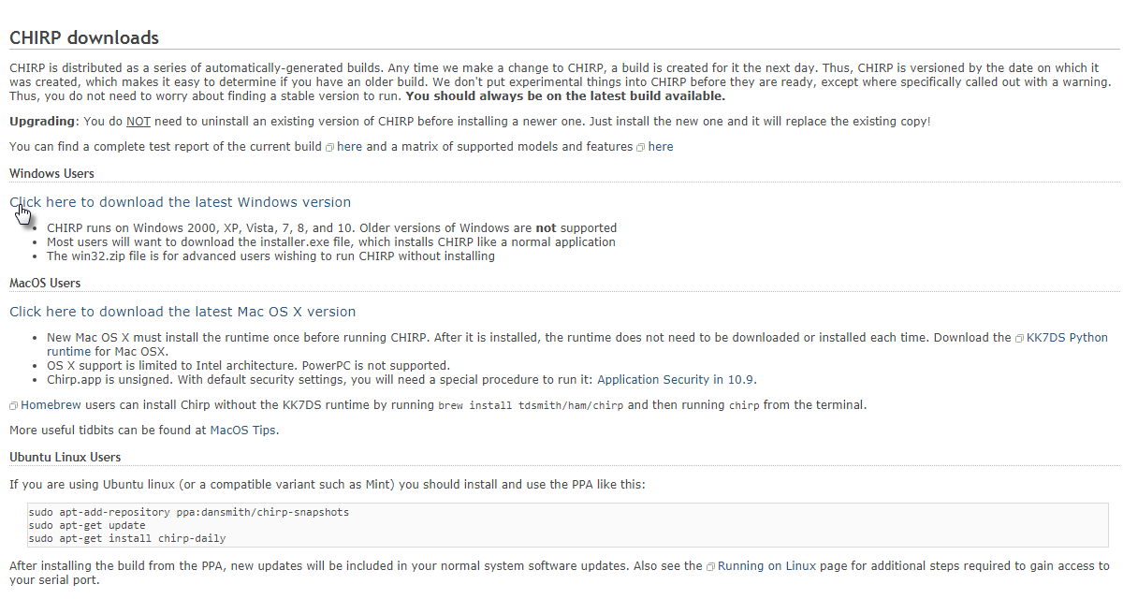
Installing CHIRP…
Got to the CHIRP homepage and click on ‘get it!’ and select the correct version for your Operating System.

Slide 10
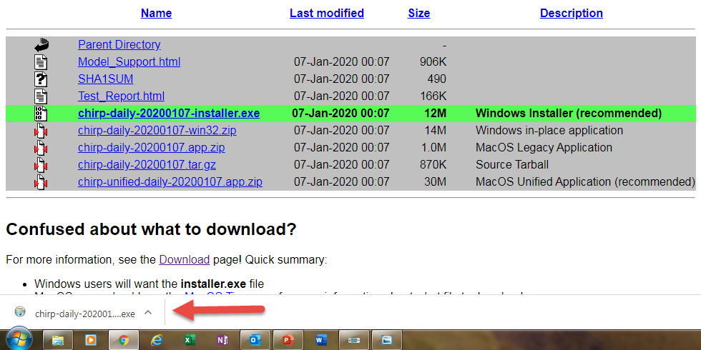
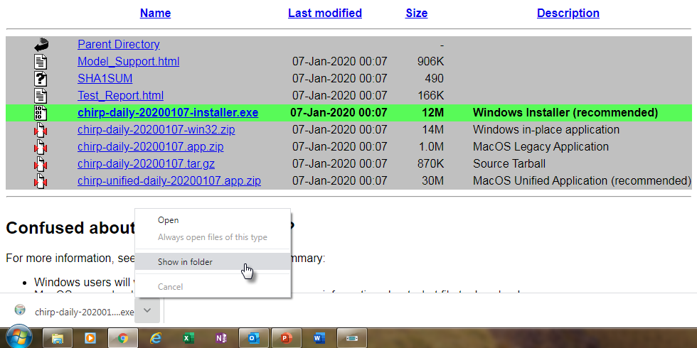
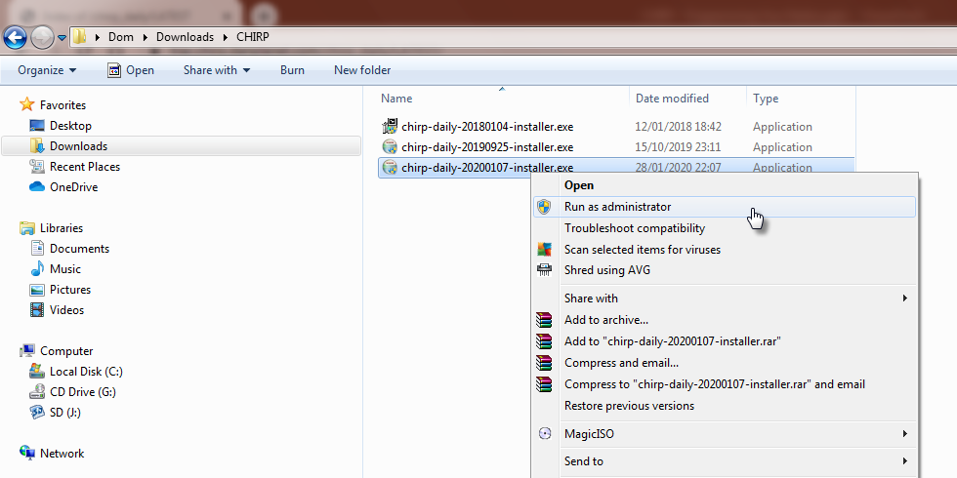
Installing CHIRP…
Follow the on-screen instructions, accept the EULA agreement and accept all the installation defaults. Once installation completes, click ‘Finish’ and CHIRP should be installed.

Slide 11
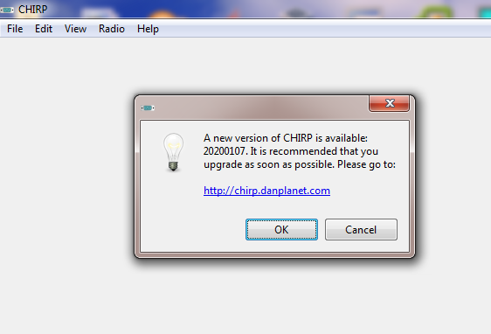
Finally! Let’s Start Using CHIRP!
You now know where your Comm ports are and you now have CHIRP installed, so let’s get to work.
Not so fast!....... If you’ve not installed the latest version of CHIRP, then you will see this message when you launch CHIRP.
If you see this, then click on the link, go and download the latest version of CHIRP and install as per the previous instructions.

Slide 12
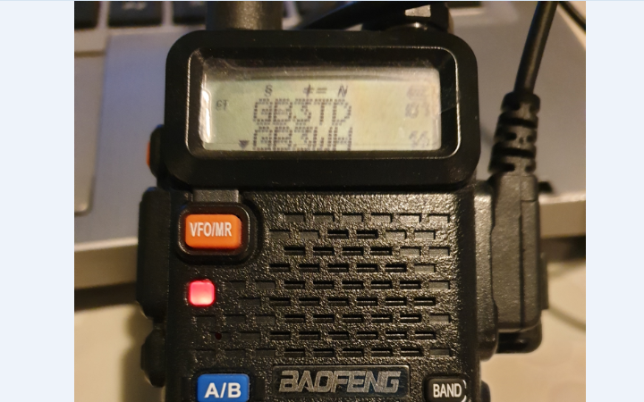
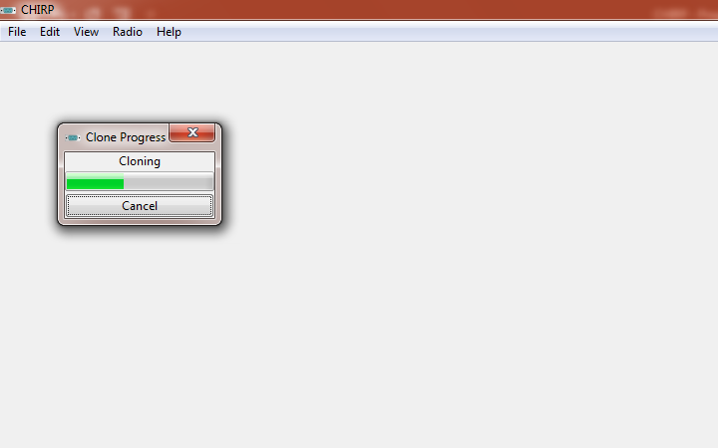
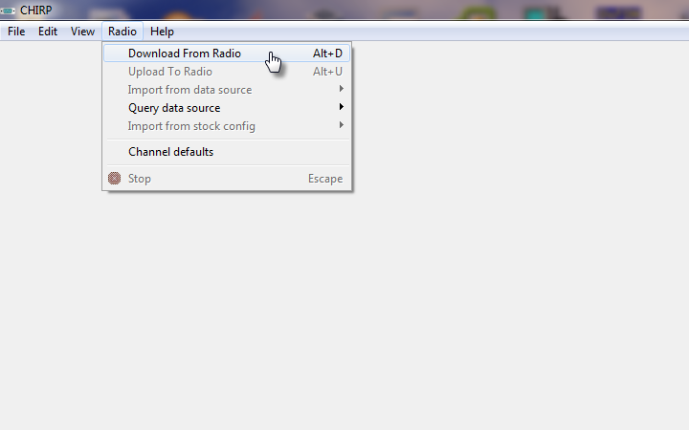
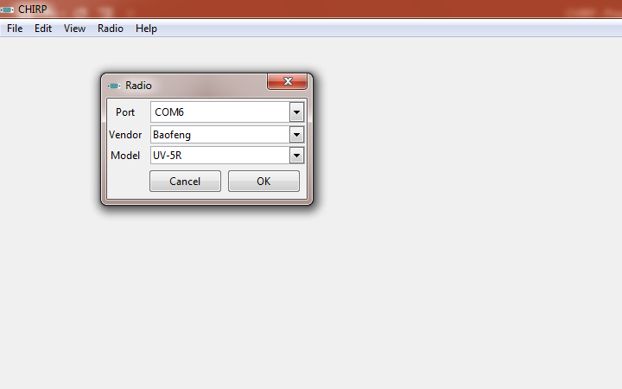
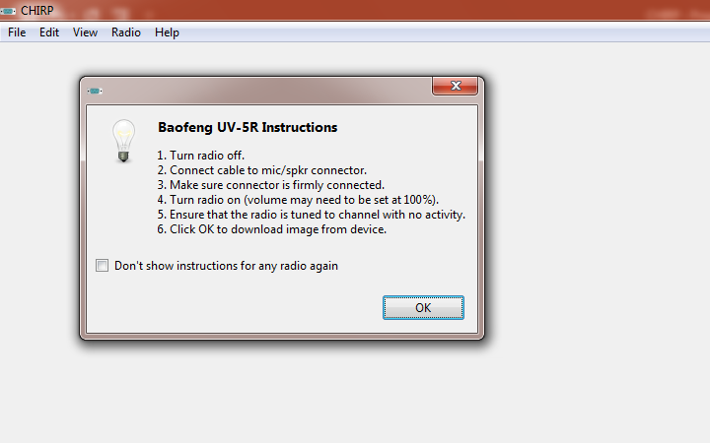
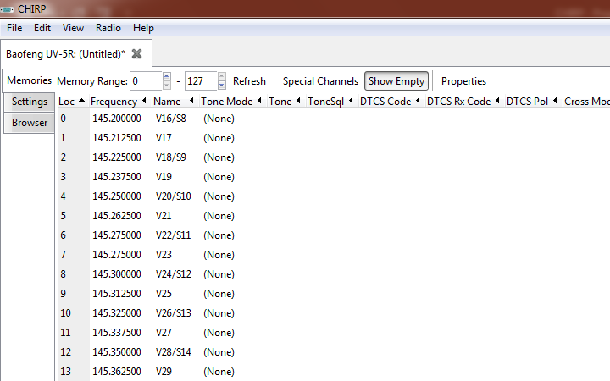
Seriously! Let’s Start Using CHIRP!
With your programming cable plugged in, your COM port identified, whilst powered OFF, connect your radio to the programming cable.
Power your radio on and start up CHIRP.

Slide 13
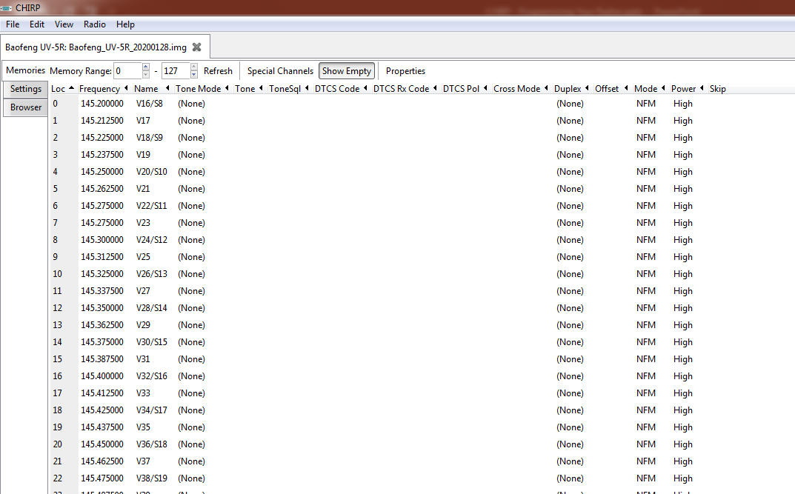
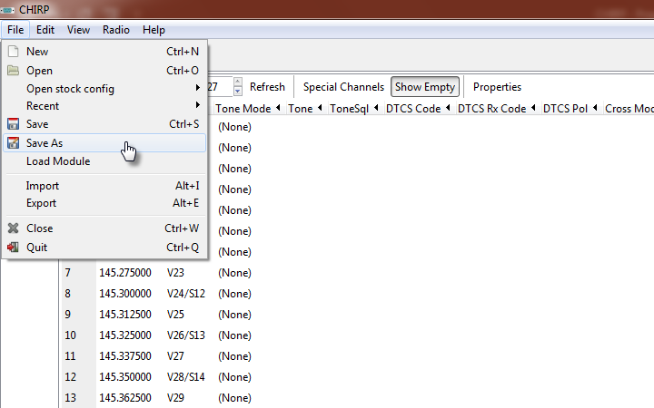
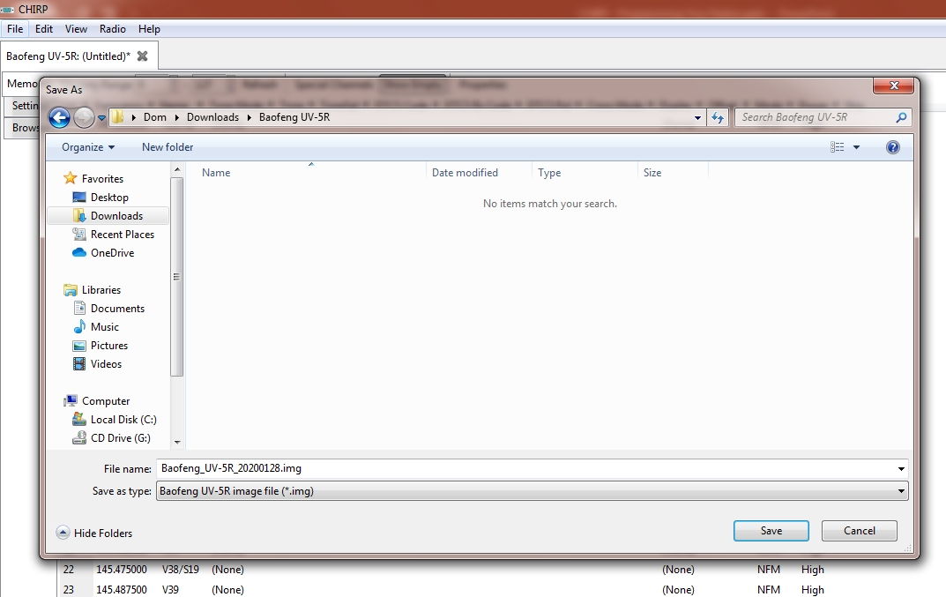
Saving Your Config. (It’s Always Good To Have A Backup)
Now you have downloaded your radio config. It’s good to save it as a backup and keep it as a known starting point.

Slide 14
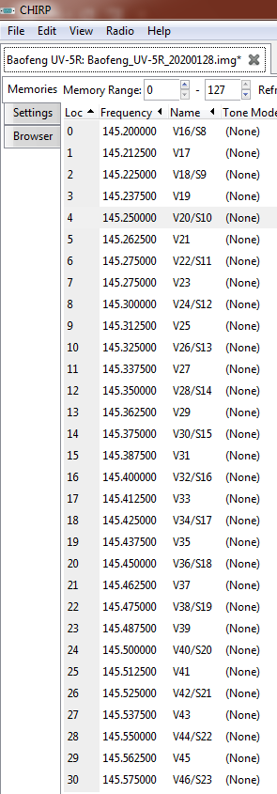
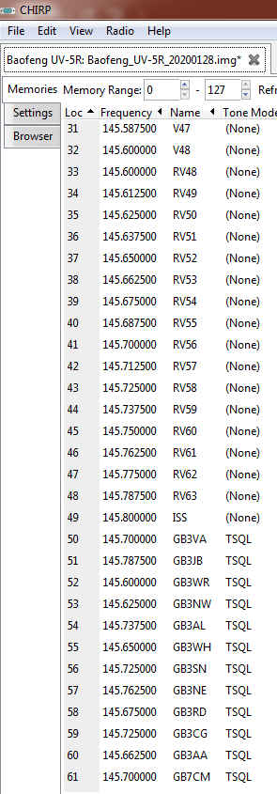
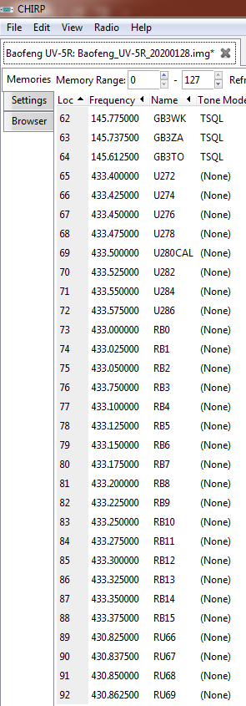
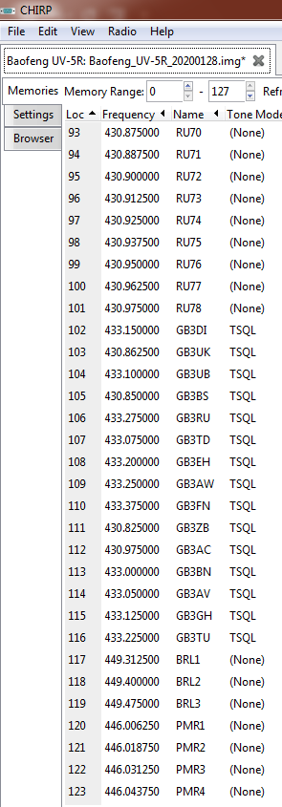
Editing Your Config. (Try To Keep It Logical)
Once you have saved your backup config. then you can start making changes. Make things logical and think about how you are going to use the radio. Remember some of the cheaper radios will have limited memory capacity, so use it wisely.

Slide 15
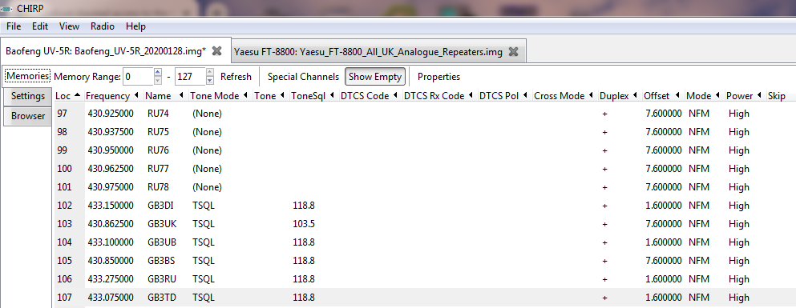
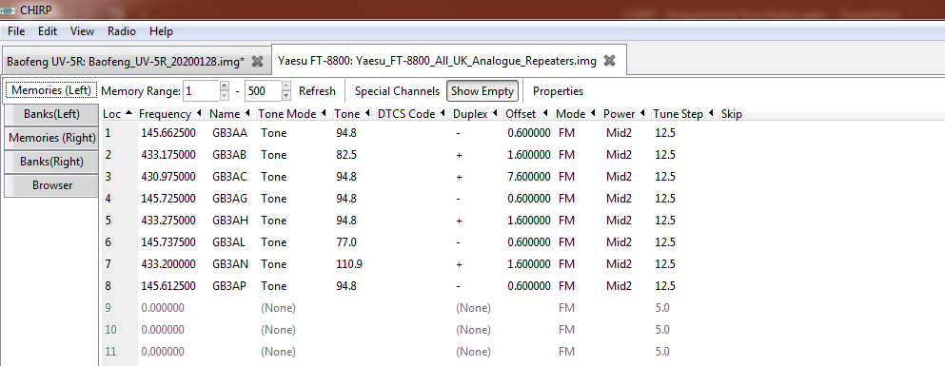
Editing Your Config. …Continued…
Fields may vary depending on the radio you are programming.

Slide 16
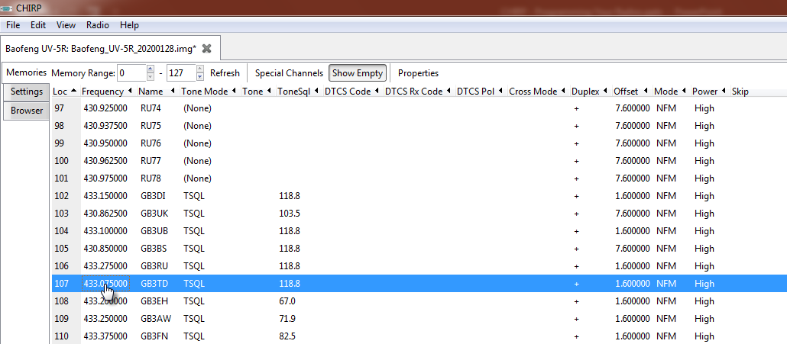
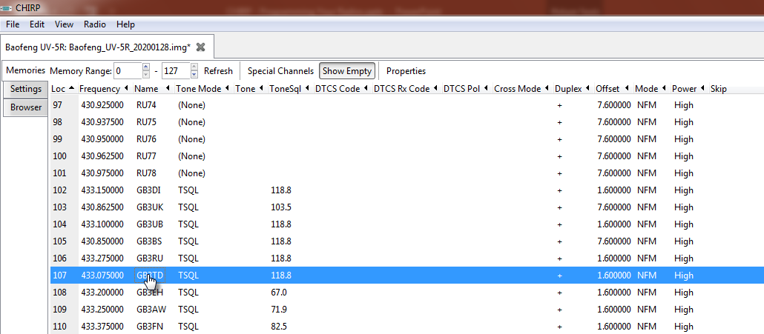
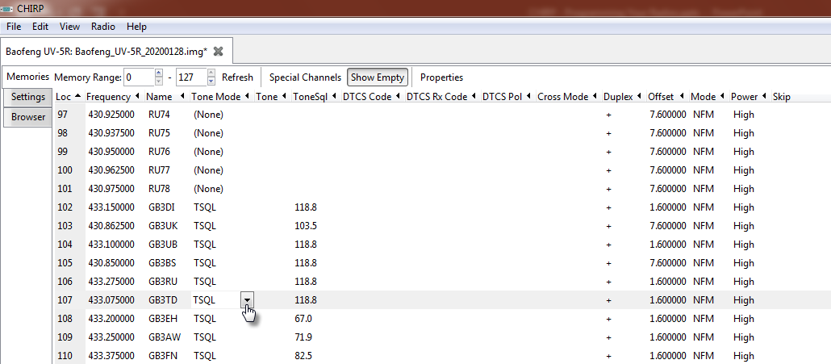
Editing Your Config. …Continued…
To edit a field, just double-click on each field and makes changes as appropriate.

Slide 17
Editing Your Config. …Continued…
What do all the Field Names mean?
Frequency – This the frequency you want the radio to receive on. This is not the receive or input frequency of the repeater.
Name – This is how the memory channel will appear on the radio screen.
Tone Mode – This is associated with your CTCSS settings. It can either be set to TONE or TSQL (Tone Squelch). For repeater operation it is generally best to set this to TSQL.
Tone/ToneSql – Use this to set your repeater CTCSS Tone frequency.
Duplex – This is your repeater shift it will be either + or – depending on the repeater shift.
Offset – For repeater operation, this is the amount of frequency offset between the receive and transmit frequencies. It is used in combination with the Duplex setting.
Mode – For FM, this will be either FM (Wide FM) or NFM (Narrow FM). For repeater operation it is best to set this to NFM.
Power – This will set the transmit output power of you radio, if that option is available on your radio.

Slide 18
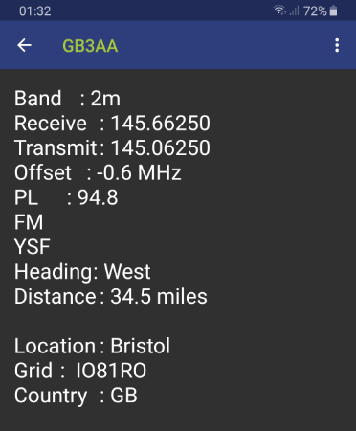
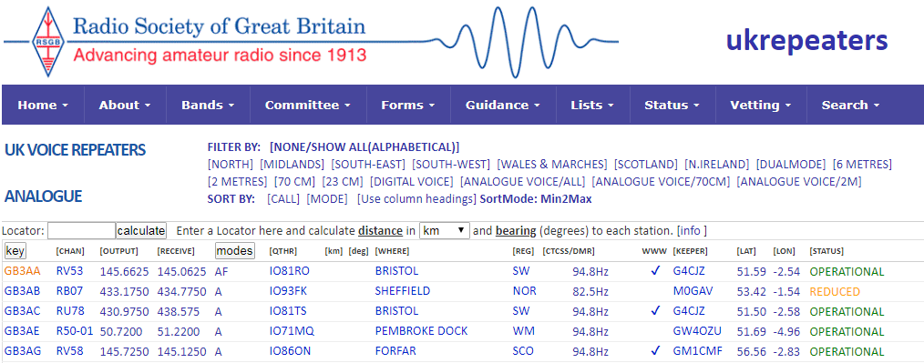
Quick Reminder About Repeater Operation
Don’t get confused with the Repeater Book App or the UK Repeater Website.
The representation of information can be a bit confusing at first. Repeater Book displays the information from YOUR radio’s perspective and the UK Repeater Website displays the information from the REPEATERS perspective.

Slide 19
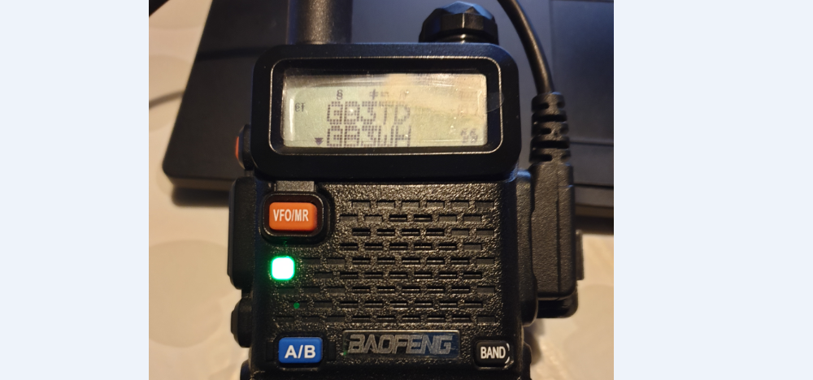
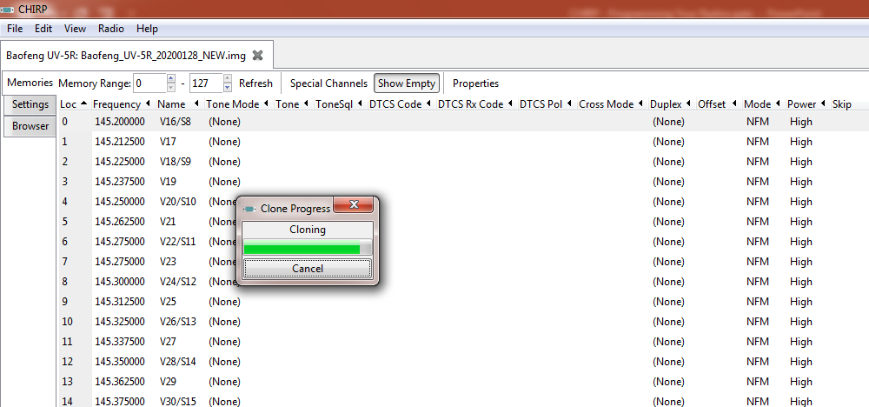
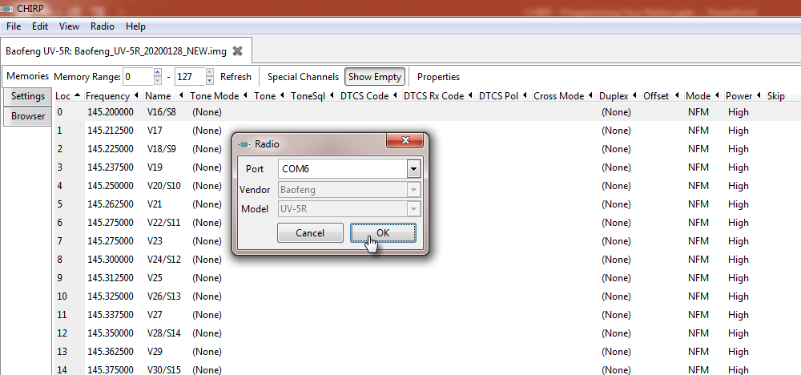
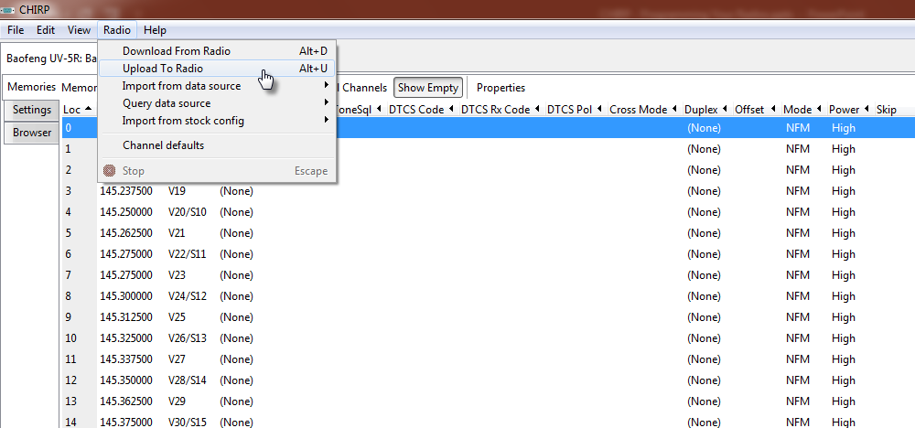
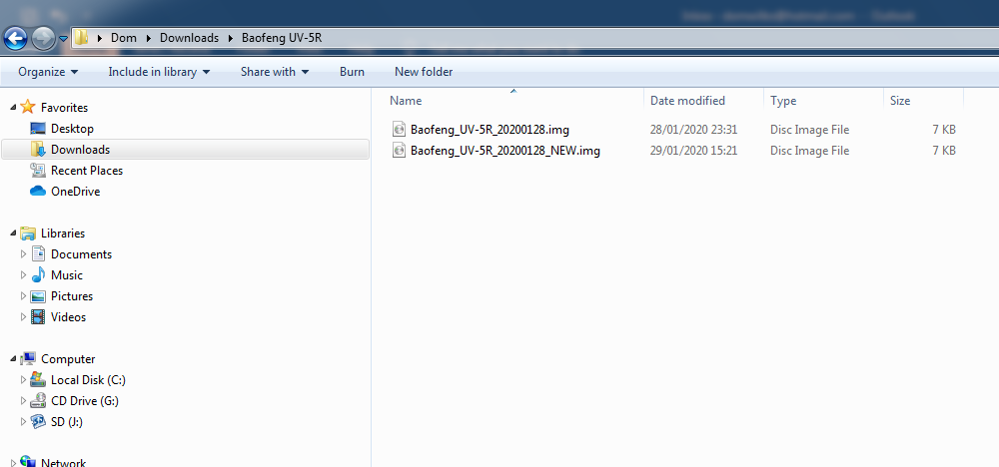
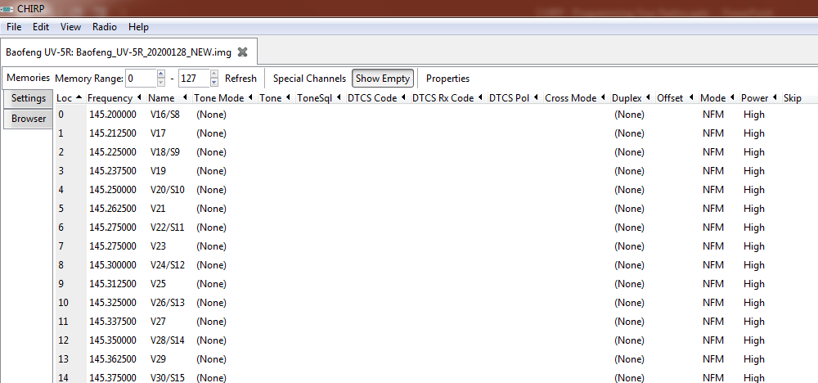
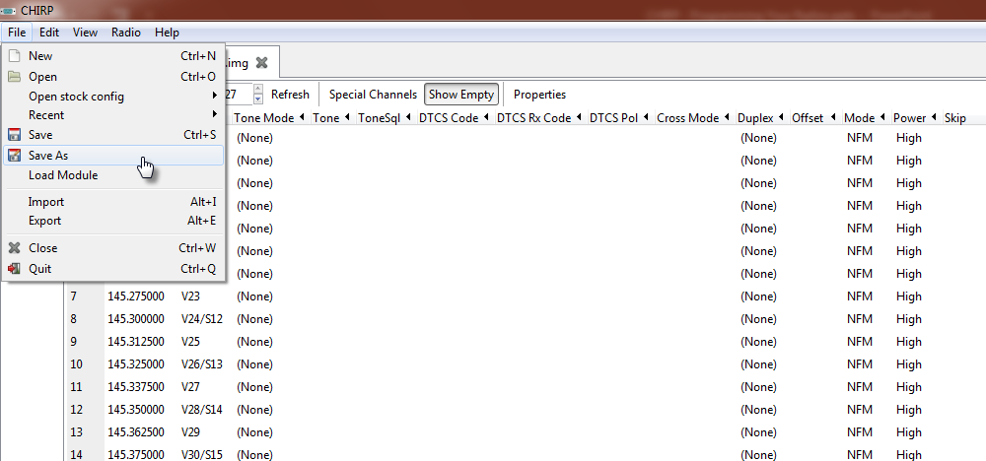
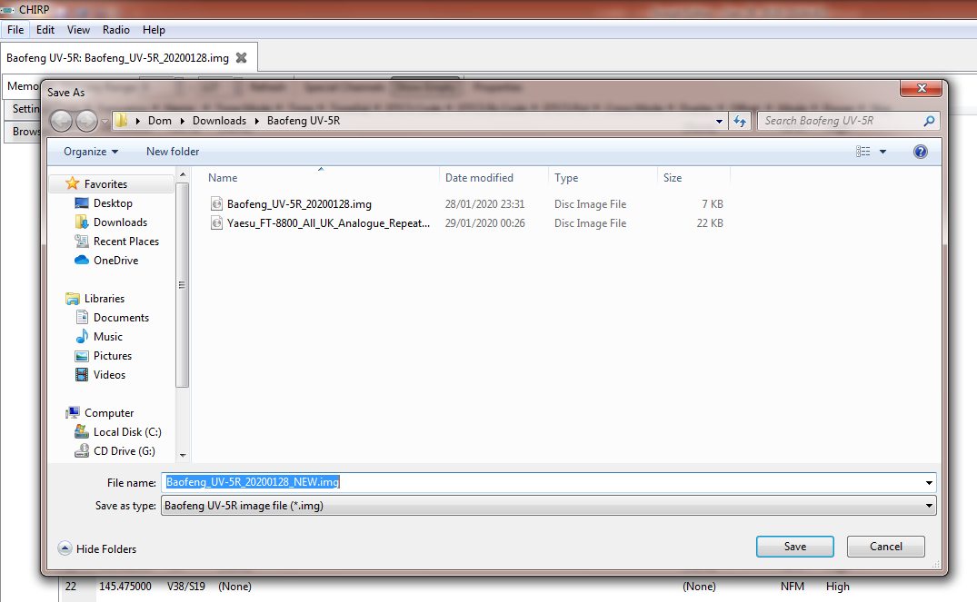
Saving The New Config. And Uploading To Radio
Once you have finished editing your configuration, you can then save a copy and upload it back to your radio.

Slide 20
That’s it! You’re Done! Your Radio Is Programmed
TIME FOR A QUICK DEMO

Slide 21
Thank you for your time and listening.
Any Questions?
73, Dom – 2E0WHQ

