Slide 1

Building A MMDVM DMR Hotspot From The Ground Up
By Dom, 2E0WHQ

Slide 2


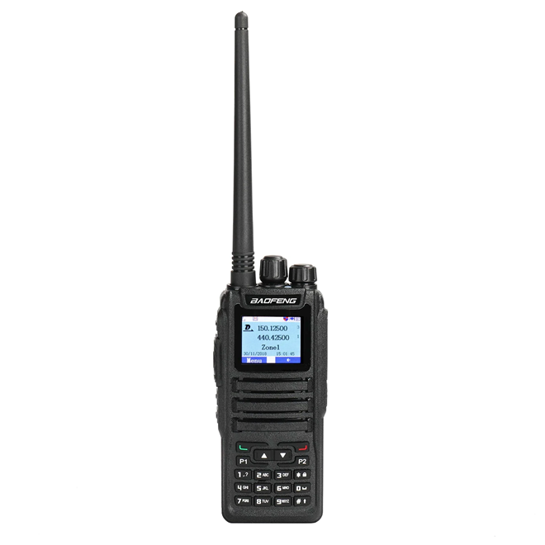




Author: Dom Wilkinson, 2E0WHQ
A VERY QUICK RECAP OF DMR
What is DMR?
Digital Mobile Radio
A method of transmitting an analogue audio modulated signal
using a digitally modulated audio signal.
The analogue voice signal is converted within the radio
using the built-in Analogue to Digital Converter (ADC) to a digital form of binary 1s an 0s. These 1s and 0s are
then transmitted, represented as audio pulses.
The receiving radio converts these audio pulses back to
an analogue audio signal using the built in Digital to
Analogue Converter (DAC) and the original voice signal
will be heard.
DAC
DAC

Slide 3

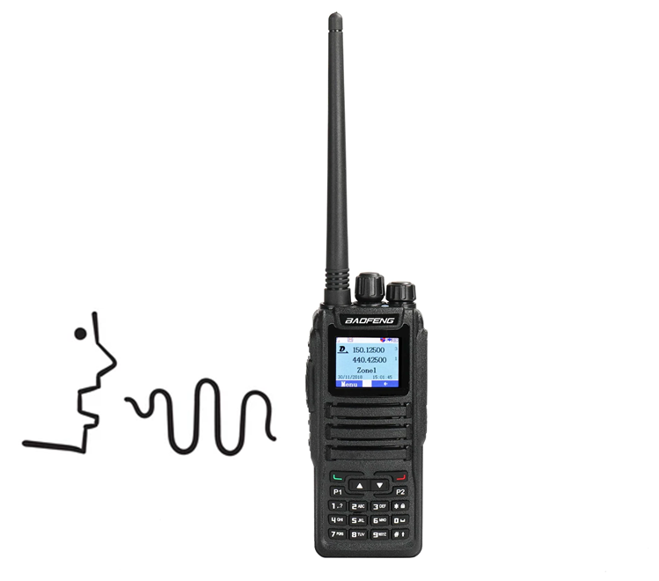
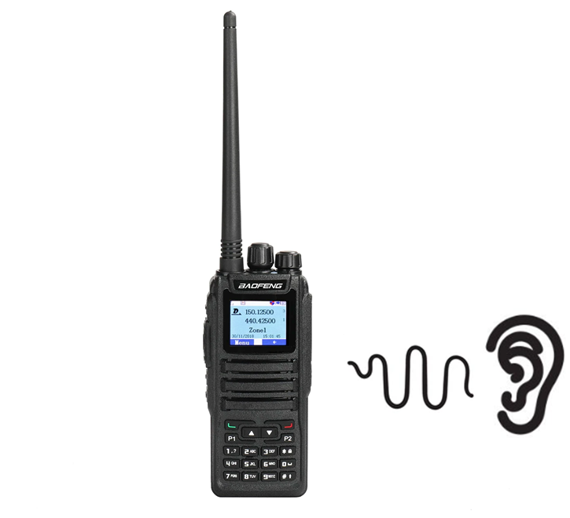









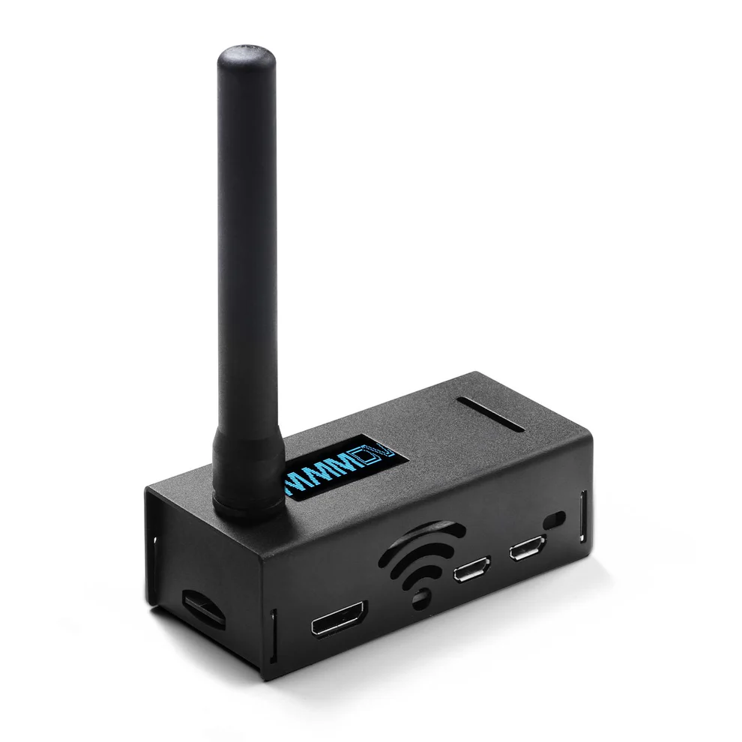

Author: Dom Wilkinson, 2E0WHQ
WHAT CAN YOU DO WITH DMR?
SIMPLEX
Local Users
World Wide
Users
REPEATER
REPEATER
HOTSPOT
MMDVM
HOTSPOT

Slide 4





Author: Dom Wilkinson, 2E0WHQ
WHAT IS A MMDVM HOTSPOT?
MMDVM
Multi-Mode Digital Voice Modem
MMDVM HOTSPOT
Consists of 4 vital components:
A Computer – Usual a Raspberry Pi miniature computer
A MMDVM (Voice Modem) – Know as a ‘HAT’ (Hardware Attached On Top) when used with a Raspberry Pi
A local Internet connection – Wifi or Ethernet. Will usually depend on the Raspberry Pi capability
Software – Running on the computer (Raspberry Pi) to control the MMDVM and access the Internet.

Slide 5

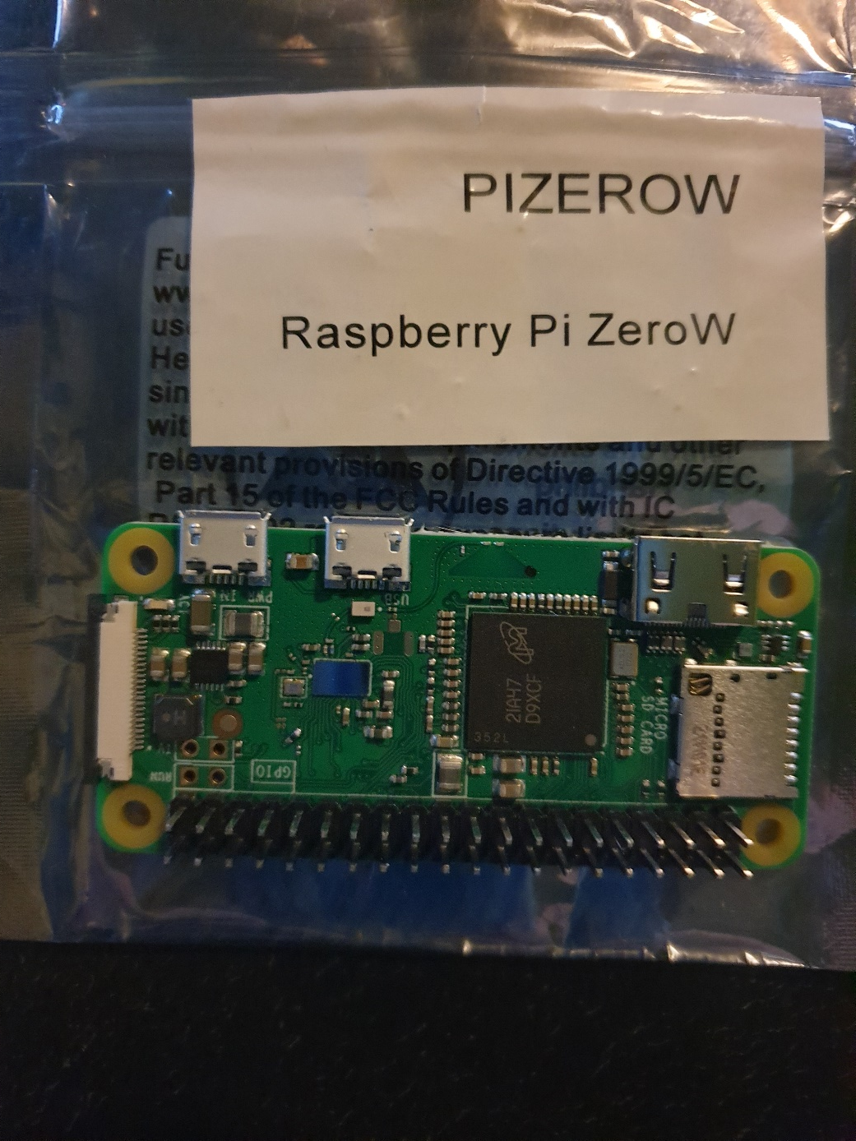
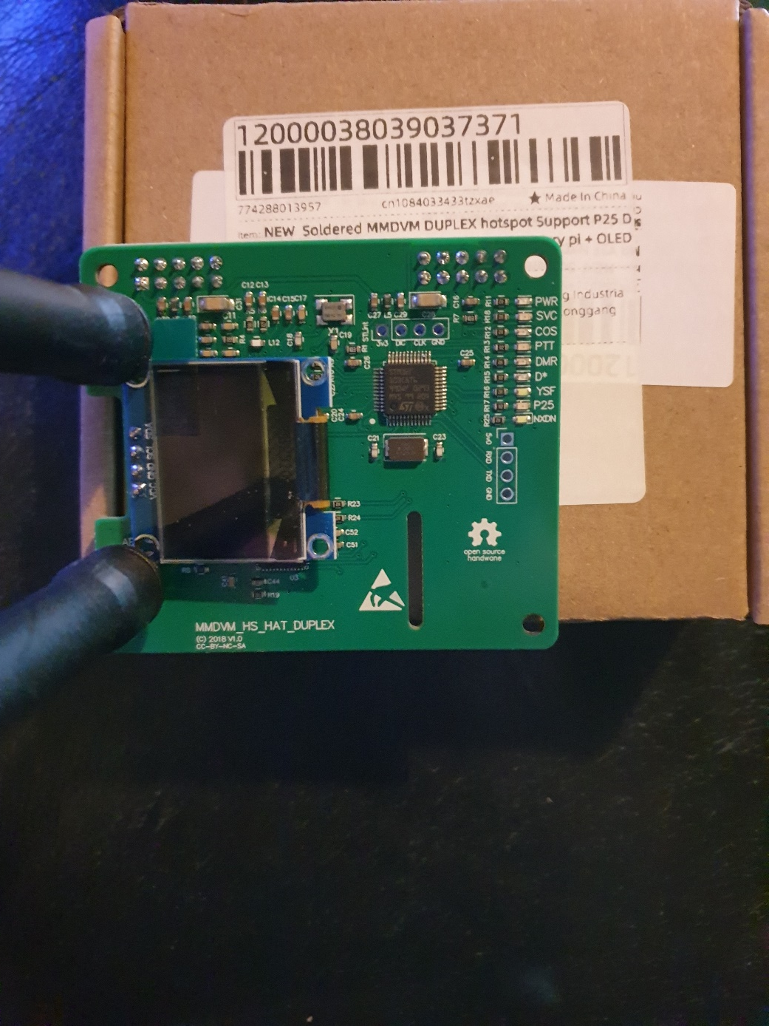
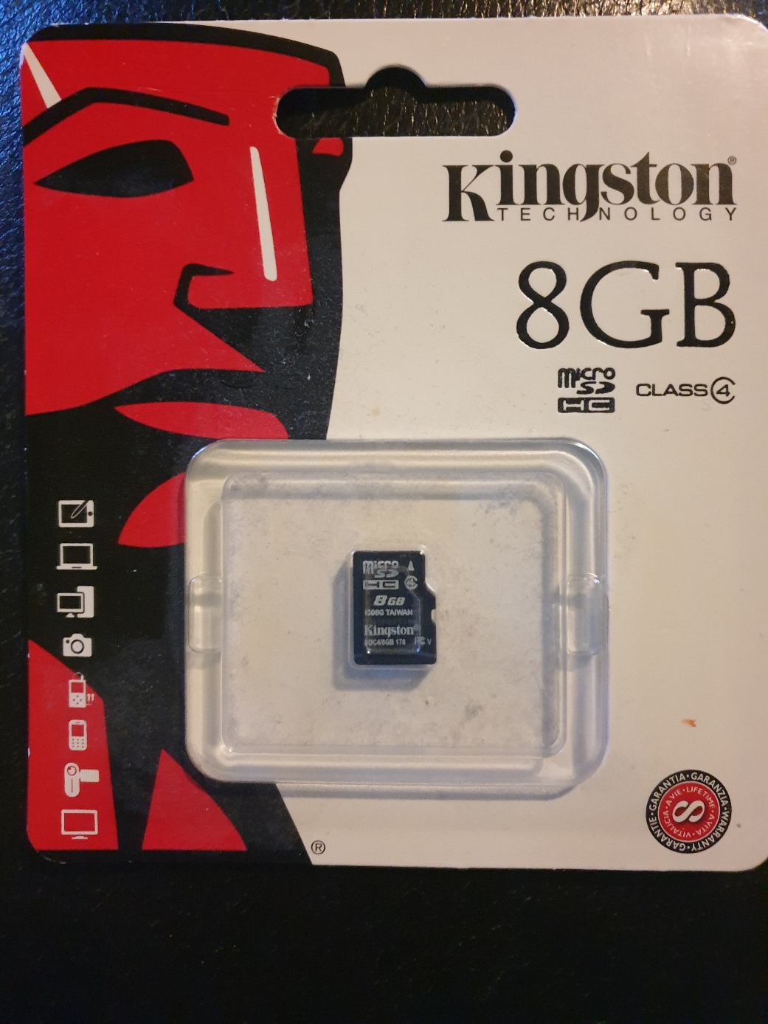
Author: Dom Wilkinson, 2E0WHQ
THE PARTS
THE COMPUTER
RASPBERRY Pi ZERO
THE VOICE MODEM
MMDVM DUPLEX HAT
THE SOFTWARE
MICRO SD CARD

Slide 6
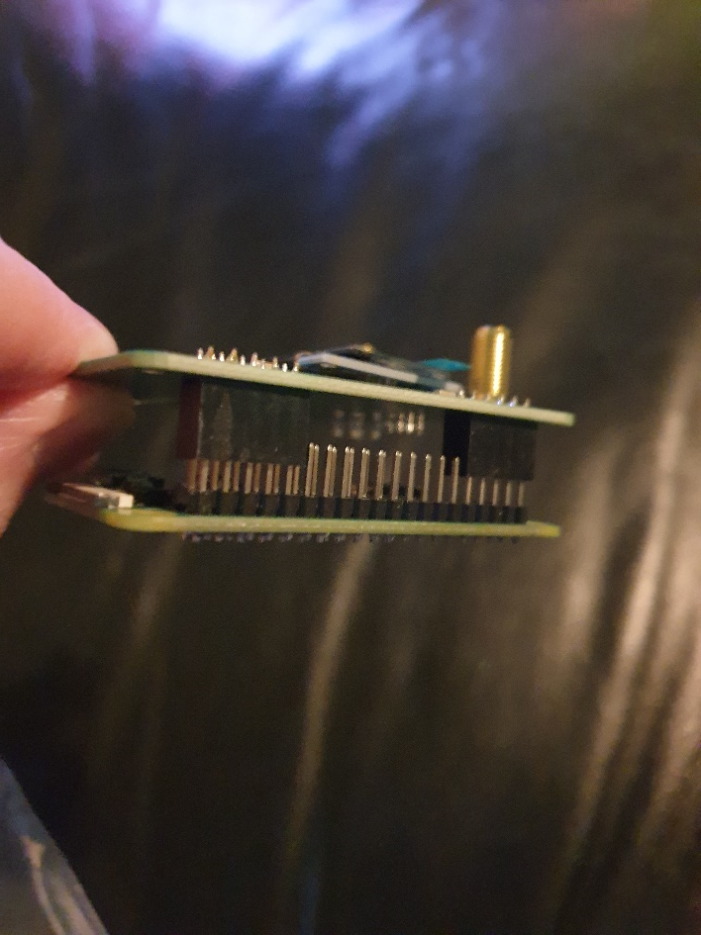
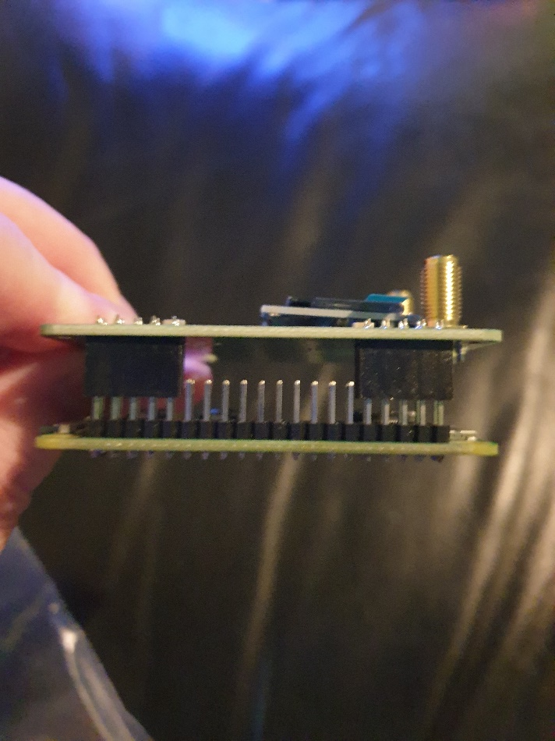
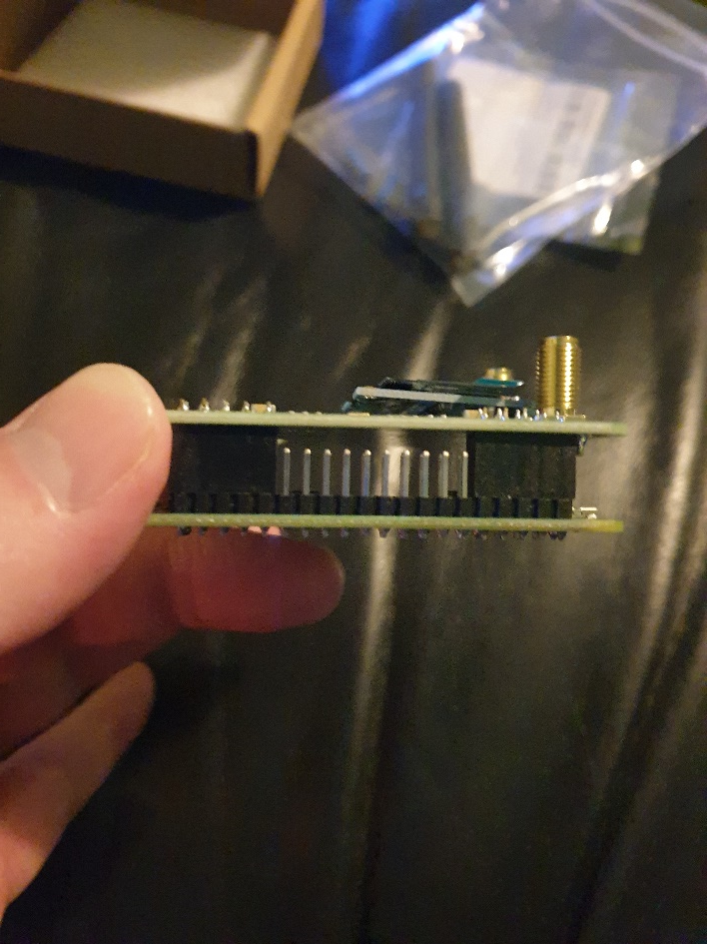
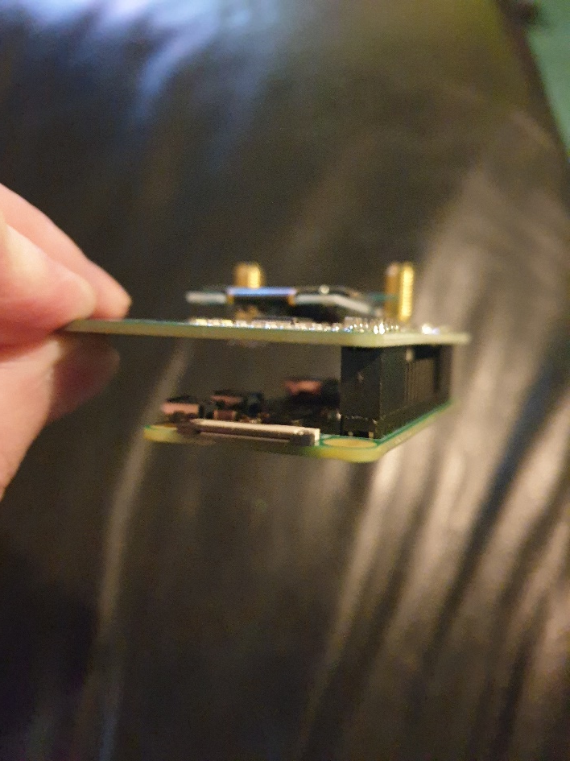
Author: Dom Wilkinson, 2E0WHQ
GETTING STARTED
ASSEMBLE PARTS
Carefully align the two sets of 10 pins on the MMDVM HAT with the I/O (Input/Output) Pins on the Raspberry Pi and
push them together gently.

Slide 7

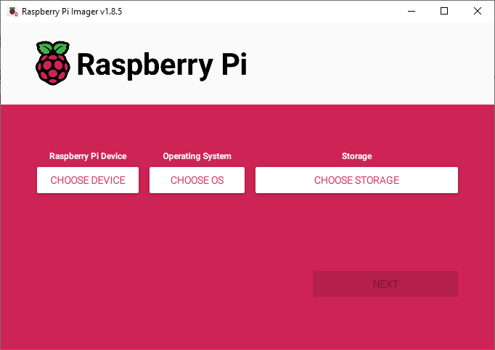
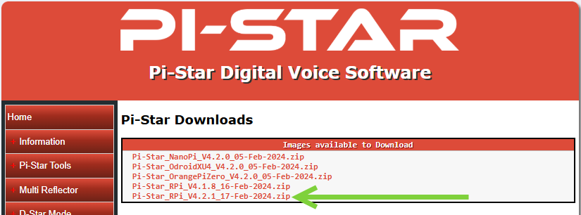
Author: Dom Wilkinson, 2E0WHQ
DOWNLOAD SOFTWARE AND PREPARE SD CARD FOR USE
DOWNLOAD IMAGING SOFTWARE
Visit https://www.raspberrypi.com/software/ and download the Raspberry Pi Imager Software for your computer Operating
System (Windows, Apple Mac, Linux). Windows installer called imager_1.8.5.exe. Run the installer file and install the Imager
software.
DOWNLOAD PI-STAR SOFTWARE IMAGE FOR RASPBERRY Pi
Visit https://www.pistar.uk/downloads and download the correct Raspberry Pi Operating System image file for the type of
Raspberry Pi which you have.

Slide 8

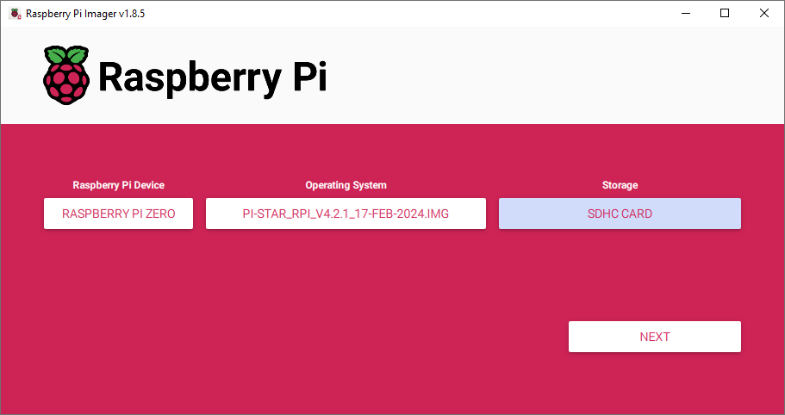
Author: Dom Wilkinson, 2E0WHQ
DOWNLOAD SOFTWARE AND PREPARE SD CARD FOR USE…cont.
UNZIP RASPBERRY PI OS IMAGE FILE
The downloaded file from the Pi-STAR website, Pi-Star_RPi_V4.2.1_17-Feb-2024.zip will need to be unzipped and it will contain
the software image file Pi-Star_RPi_V4.2.1_17-Feb-2024.img. We’ll now use this file to create the Operating System boot drive
on the Micro SD Card for the Raspberry Pi.
‘IMAGE’ THE MICRO SD CARD
Insert the Micro SD Card in to you computer and start the Raspberry Pi Imager software which you previously downloaded.
Select the correct model of Raspberry Pi which you have, then select ‘Custom’ for the Operating System and locate the image
file, Pi-Star_RPi_V4.2.1_17-Feb-2024.img, which you have just unzipped. Finally select the Micro SD Card from the Storage
option. Click ‘NEXT’ and follow the instructions. This imaging process can take up to 20 minutes to complete. Be patient.

Slide 9

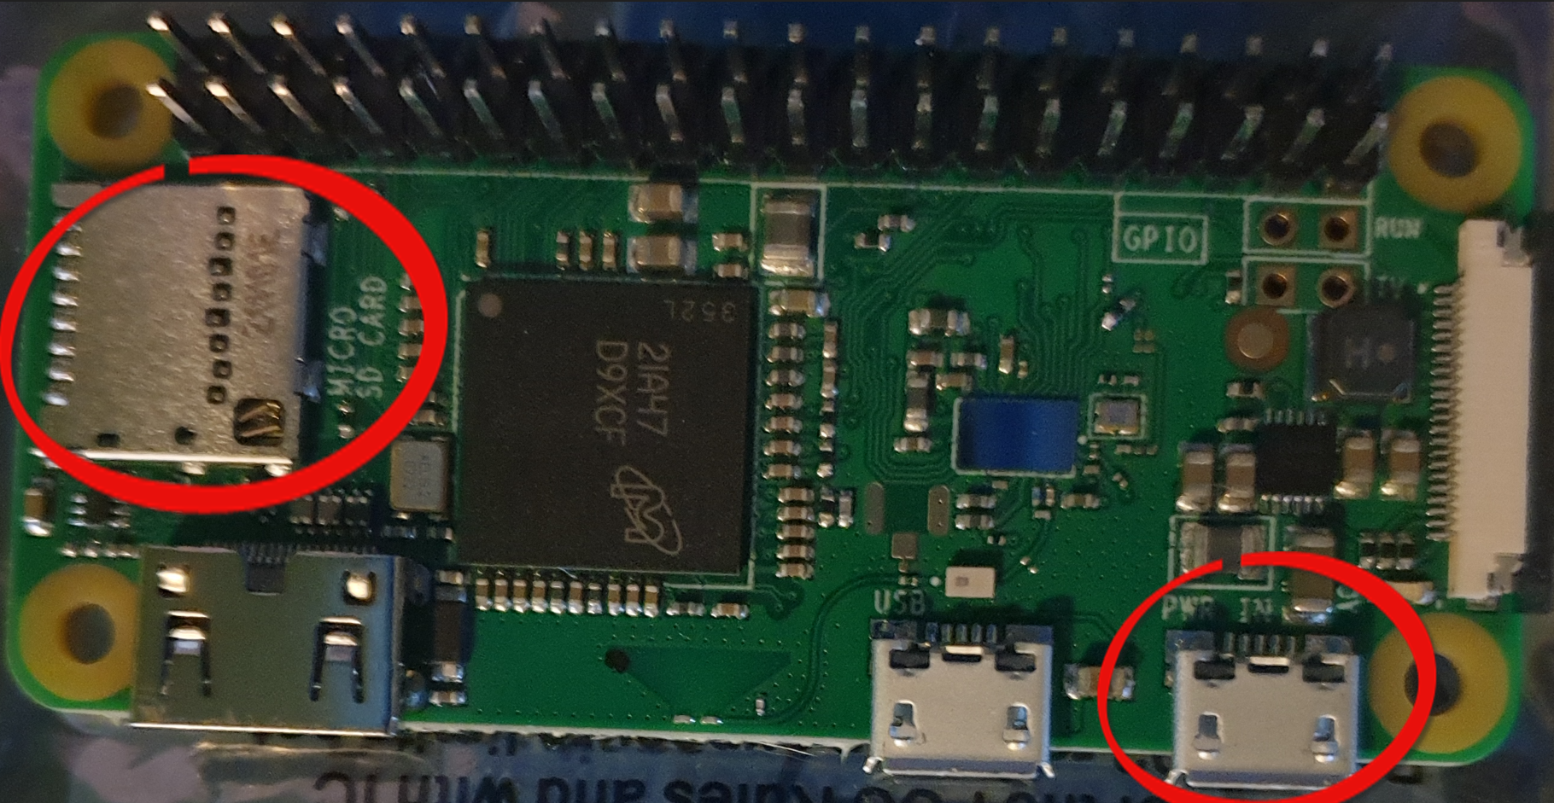
Author: Dom Wilkinson, 2E0WHQ
BOOTING UP YOUR RASPBERRY Pi & MMDVM HOTSPOT FOR THE FIRST TIME
Insert Micro SD Card & Apply Power
Be careful to put the SD Card in the right way up (gold pins down). Don’t force it, just push until it stops (no click).
Attach power to the first Micro-USB port on the right, for a Raspberry Pi Zero (check PWR port on other models).

Slide 10

Author: Dom Wilkinson, 2E0WHQ
UNDERSTANDING THE INITIAL SETUP STEPS
SETUP STEPS ORDER
MMDVM Hotspot will initially boot as a standalone wireless access point.
You will connect, via wireless, from your laptop/computer to this standalone wireless access point.
Once connected, you will use your browser to connect to the MMDVM Hotspot configuration page
and configure the MMDVM Hotspot to connect to your HOME Wi-Fi Internet connection.
Once configured, the configuration will be saved & the MMDVM Hotspot rebooted.
Upon reboot, the MMDVM Hotspot should connect to your HOME Wi-Fi and be able to connect to
the Internet and you should be able to browse to the MMDVM Hotspot configuration page using
the IP Address it has been assigned on your HOME Wi-Fi.
LIVE DEMO AT END TIME PERMITTING!

Slide 11

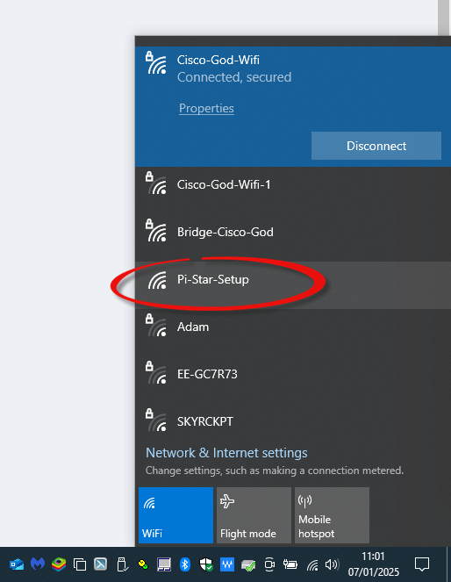
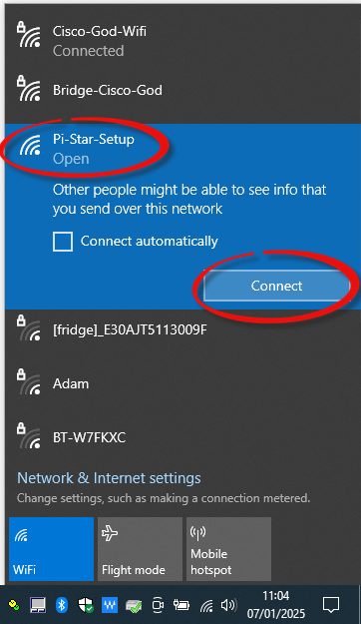
Author: Dom Wilkinson, 2E0WHQ
WHAT TO EXPECT DURING THESE STEPS
ON YOUR LAPTOP/COMPUTER
You will see a new Wi-Fi network appear called ‘Pi-Star-Setup’
Select this Wi-Fi network and connect. If your HOME Wi-Fi is set to ‘Connect Automatically’,
it can help to disable this temporarily during this stage to prevent hopping between networks.

Slide 12
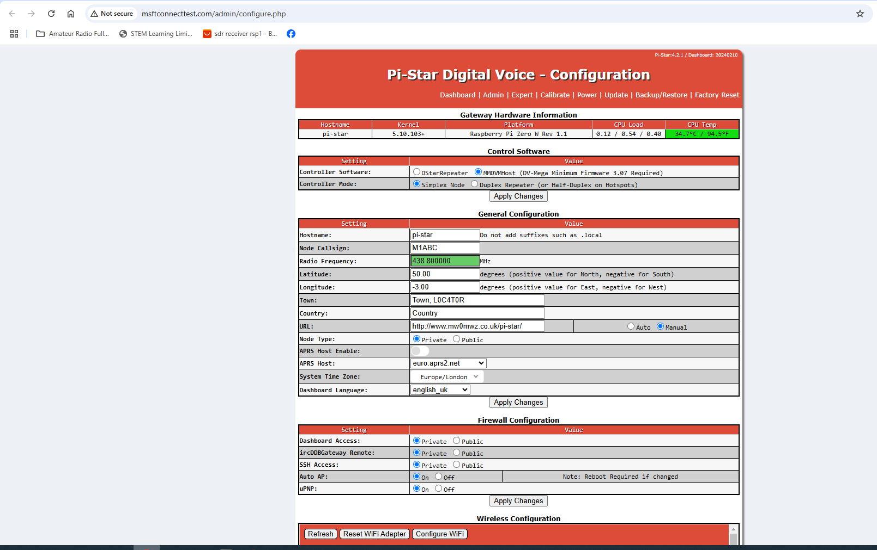
Author: Dom Wilkinson, 2E0WHQ
WHAT TO EXPECT DURING THESE STEPS…cont.
ON YOUR LAPTOP/COMPUTER
If you have got your browser open, then it should open up a new tab to the page http://www.msftconnecttest.com/redirect
or you will be prompted to open your browser, which then should open the same page.
This is the Web GUI (Graphical User
Interface) which you will use to configure
your MMDVM Hotspot, but first we need
to connect it to your HOME Wi-Fi

Slide 13
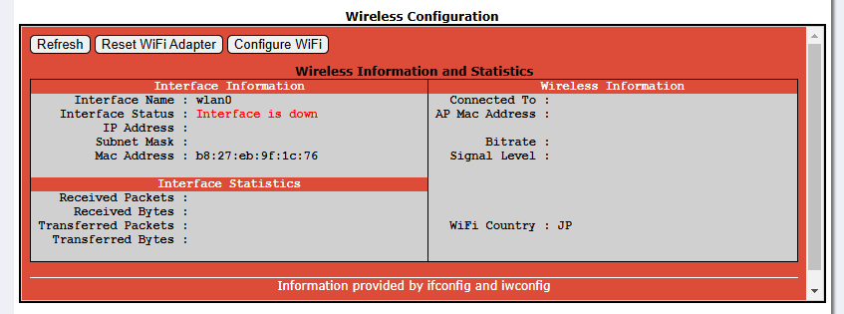
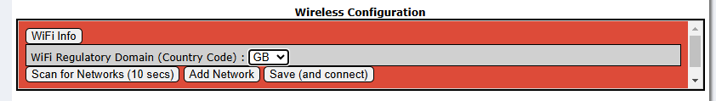
Author: Dom Wilkinson, 2E0WHQ
CONNECTING YOUR MMDVM HOTSPOT TO YOUR HOME Wi-Fi
TOP-TIP BEFORE YOU START
Once your MMDVM Hotspot has connected to your HOME Wi-Fi, you’ll need to find its IP Address, on your HOME Wi-Fi
network, which some can find a bit difficult, so I would recommend downloading this simple Advanced IP Address Scanner
Software, which will help you locate your MMDVM Hotspot on your network.
Visit https://www.advanced-ip-scanner.com/download/ and the software should download automatically. More that later.
From the Web GUI scroll down to the ‘Wireless Configuration’ Section and select ‘Configure WiFi’
Change the WiFi Country Code to GB
We’re now ready to scan for your HOME Wi-Fi network

Slide 14
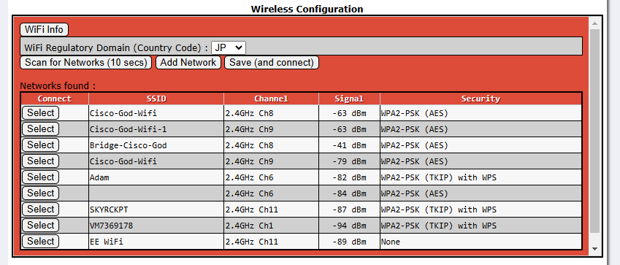
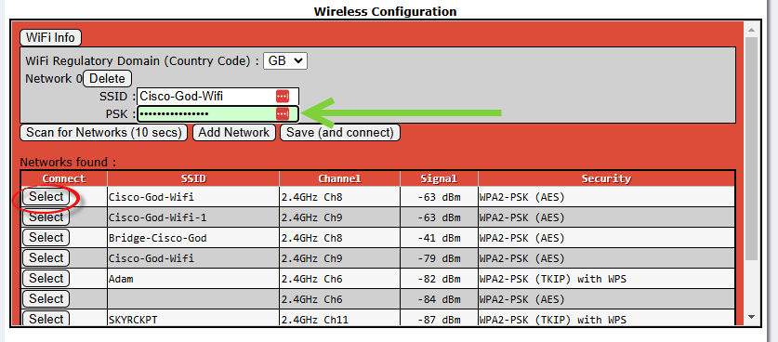
Author: Dom Wilkinson, 2E0WHQ
CONNECTING YOUR MMDVM HOTSPOT TO YOUR HOME Wi-Fi…cont.
SCAN NETWORKS AND CONNECT TO YOUR HOME Wi-Fi
Click ‘Scan for Networks’
After about 10 seconds, a list of available Wi-Fi networks
will appear. Select your HOME Wi-Fi from the list of
available networks.
NOTE: The WiFi Country Code will probably change back
to JP, make sure you change it back to GB.
Once you’ve selected your HOME Wi-Fi network, you’ll
need to type in your HOME Wi-Fi password.
Click ‘Save (and connect)’.
At this point, you’ll probably get disconnected from the
Web GUI.

Slide 15
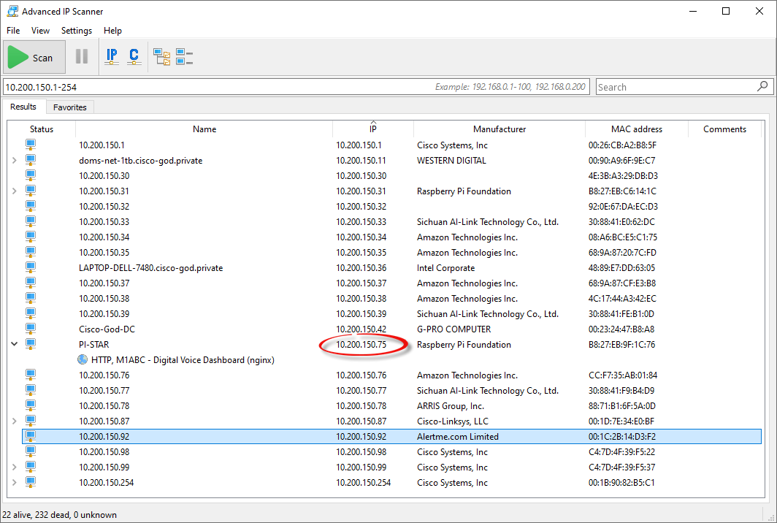
Author: Dom Wilkinson, 2E0WHQ
CONNECTING YOUR MMDVM HOTSPOT TO YOUR HOME Wi-Fi…cont.
FINGERS CROSSED, EVERYTHING HAS WORKED!
Once you’ve clicked the ‘Save (and connect)’, you might find the Web GUI becomes unstable and you might not be able to
connect to it correctly and you might find that the connectivity to the Pi-Star-WiFi network will keep going up and down. If this
happens, then this is the ONE AND ONLY TIME you should disconnect the Raspberry Pi from the power, wait 10 seconds and
then plug it in again. When it reboots, it should hopefully connect to your HOME Wi-Fi.
To find the IP Address of your MMDVM Hotspot, use the Advanced IP Scanner Software which you downloaded earlier. Scan
your HOME Wi-Fi network and find the device with the name ‘PI-STAR’. That will be your MMDVM Hotspot.

Slide 16
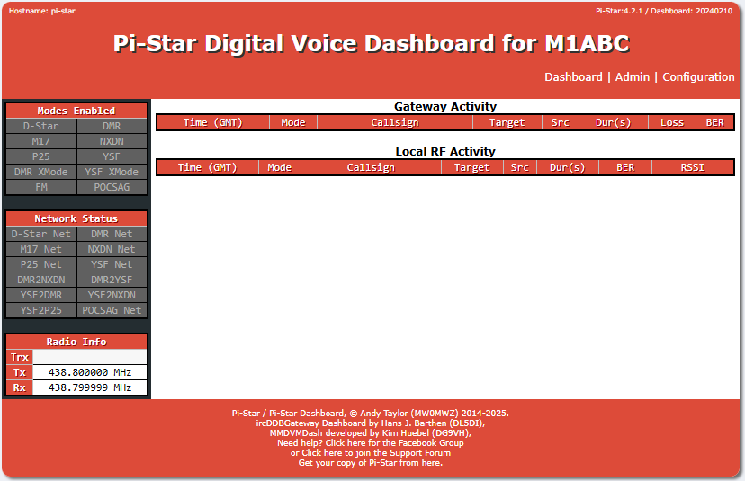
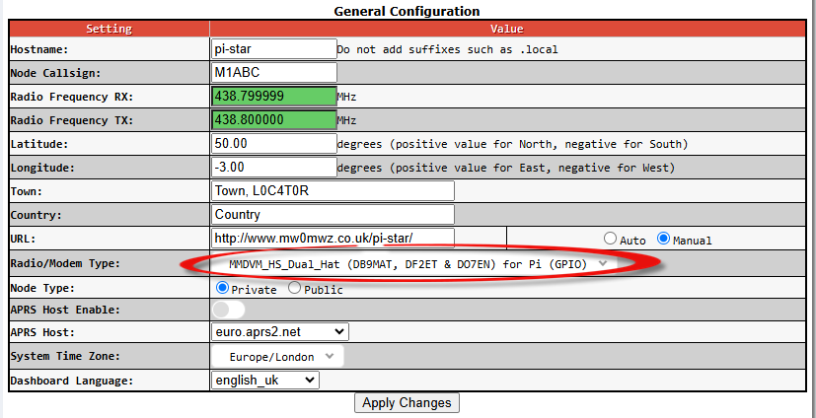
Author: Dom Wilkinson, 2E0WHQ
TIME TO START CONFIGURING YOUR MMDVM FOR RADIO
Browse to the IP Address of your MMDVM Hotspot
Open your browser and type in the address bar http://<IP Address of Hotspot>. This is the IP Address you previously identified.
e.g. http://10.200.150.75
The Web GUI screen should be visible. Select
‘Configuration’ and the main configuration
page should appear.
We first need to select the correct Modem Type which is being used.
Scroll down to the ‘General Configuration’ section and find the
correct Modem from the drop down list or use the search function.
Here we are using the Dual-Band MMDVM HAT. Click ‘Apply Changes’.

Slide 17
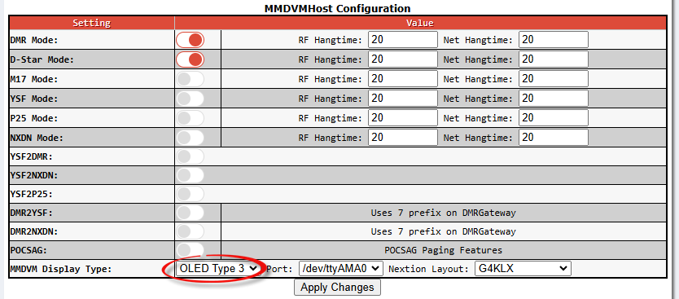
Author: Dom Wilkinson, 2E0WHQ
CONFIGURING YOUR MMDVM FOR RADIO
CONTINUING THE CONFIGURATION
Each time you click ‘Apply Changes’ the software will stop and restart various services.
Avoid making multiple changes, make small changes and apply them regularly. This seems to prevent configuration problems.
Next go to the ‘MMDVMHost Configuration’ and switch on the modes you want to use and select the type of LED screen your
MMDVM has. Here we are enabling DMR and D-STAR and we’ve selected the OLED Type 3 LED screen.
After we have applied that change and DMR & D-STAR enabled, we can go ahead and configure the login credentials for DMR
and D-STAR.
NOTE: You will need to register for a DMR & D-STAR login, as you need these to be able to connect to these services.

Slide 18
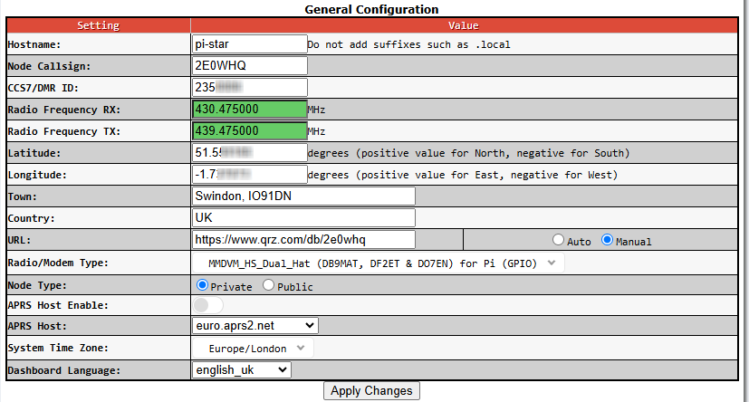
Author: Dom Wilkinson, 2E0WHQ
CONFIGURING YOUR MMDVM FOR RADIO…cont.
Next we can go back to the ‘General Configuration’ section and configure the personal details for your MMDVM Hotspot,
including the Node Callsign, personal DMR ID, the frequency which you want your MMDVM Hotspot to operate on.
NOTE: On a Simplex Hotspot, you will only have to configure a single TX/RX frequency, but on a Duplex Hotspot, you’ll need
to configure a TX and RX frequency, similar to a repeater duplex shift. Ensure that you refer to the RSGB Band Plans to make
sure that you use frequencies within the allocated frequency ranges.
Node Callsign will usually be your callsign
This a Duplex MMDVM so it has a TX/RX frequency
split of -9Mhz configured.
Fill in the remaining personal details including Lon/Lat,
Town, Country and link to QRZ.COM is you want.
Click ‘Apply Changes’ and wait for the services to restart.

Slide 19
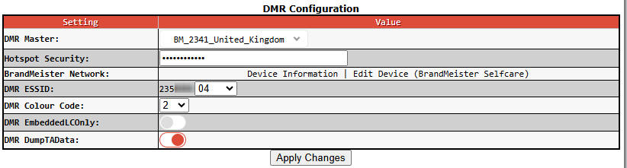
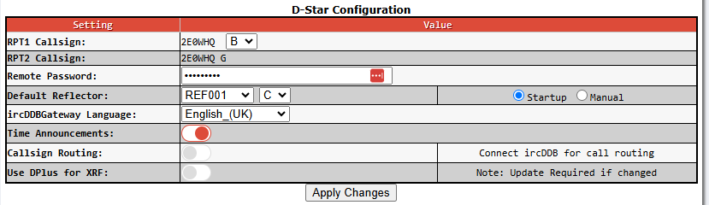
Author: Dom Wilkinson, 2E0WHQ
CONFIGURING YOUR MMDVM FOR RADIO…cont.
FINAL CONFIGURATION
Once the personal details have been applied and saved, the final step is to setup your DMR and D-STAR connection. Scroll to the
‘DMR Configuration’ and ‘D-Star Configuration’ where we configure how we want to connect to the DMR network and access to
the D-STAR network. As mentioned in previous presentations, there are several ‘suppliers’ who provide access to the DMR
network. The two most common are Phoenix and BrandMeister. I personally prefer to use BrandMeister, so in this demo, I’ll be
configuring DMR to use BrandMeister.
I’ve configured the UK BrandMeister Node to be the
DMR Master node, which my MMDVM Hotspot will
connect to over the Internet.
The ‘Hotspot Security’ is the password which you
have set in your BrandMeister account.
The ‘DMR ESSID’ is your DMR ID. The variable number
at the end of your DMR ID can be set to 01 if you
only have 1 Hotspot, I’ve set this to 04 as I have 4
Hotspots.
For the D-STAR setup, you just need to add your
D-STAR password, which you setup when you
registered for D-STAR and your ‘Default Reflector’.
Reflector 001C (REF001 & C) is the most common.

Slide 20
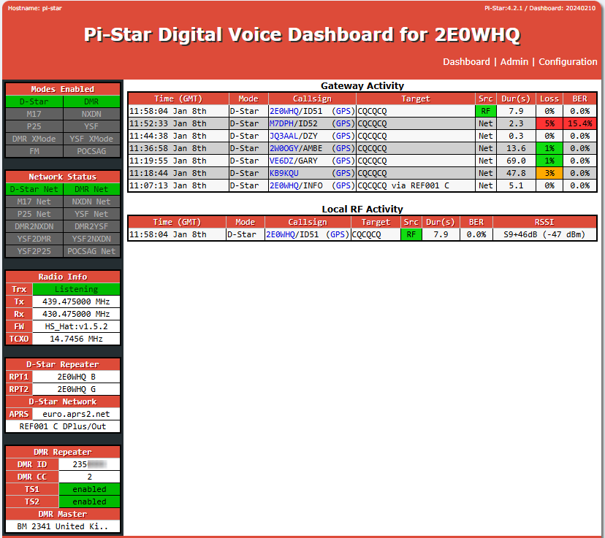
Author: Dom Wilkinson, 2E0WHQ
FINAL VERIFICATION & TESTING
NETWORK CHECK & TEST CALLS
Hopefully, now your MMDVM Hotspot should now be configured and ready for use.
Check ‘Modes Enabled’
are GREEN.
Check ‘Gateway Activity’ log for
recent activity. The first, lowest
entry should be your MMDVM
Hotspot announcing itself on
the network.
Check ‘Network Status’
are GREEN. If they are
AMBER, then this usually
indicates a authentication
or password problem. If
they are RED, then this
will usually indicate a
network or Internet
problem.
Put out a test call and check the
‘Local RF Activity’ to see your RF
call in the log and check the
‘Gateway Activity’ to see your
call going out to the Internet via
the gateway.
Check ‘D-Star Repeater’ Settings for
The correct Reflector Connection
Here it’s Reflector 01 C.
In this example, I made a test
call on D-Star on Reflector 01C
from my ICOM ID51 handheld. We can see the call inbound as
a RF call.
Check your local D-Star and
DMR Repeater Settings.
Local DMR Colour Code,
Time Slots Enabled.

Slide 21
Author: Dom Wilkinson, 2E0WHQ
THANK YOU FOR LISTENING & STICKING WITH ME
ANY QUESTIONS?
LIVE DEMO TIME PERMITTING!

