Slide 1

Microcontrollers & Microcomputers
3 Quick, 10-Minute Projects
By Dom, M9WHQ

Slide 2

Author: Dom Wilkinson, M9WHQ
PRESENTATION AGENDA
What will this talk be covering?
Brief Introduction To Each Project
- I’ll describe each project and its practical use. Due to time limitations, there will
not be a full, in-depth, deep-dive in to every project, but enough information to get
you going. NO PREVIOUS EXPERIENCE IS REQUIRED.
Hardware & Software Required
- I’ll explain what Hardware and Software is required for each project.
Practical Demonstration Of Setup
- I’ll demonstrate how to build, setup and configure each project. Due to time
limitations, some of the steps may be abridged, but where possible, I’ll show the entire
build process to demonstrate how easy it is to have a go at building each project.
What Projects Are We Going To Build?
- TinyGS Satellite Ground Receiving Station
- 3-in-1 ADS-B, ACARS & Radiosonde Receiving Station
- Meshtastic LoRa Licence-Free Tracking & Messaging Device

Slide 3

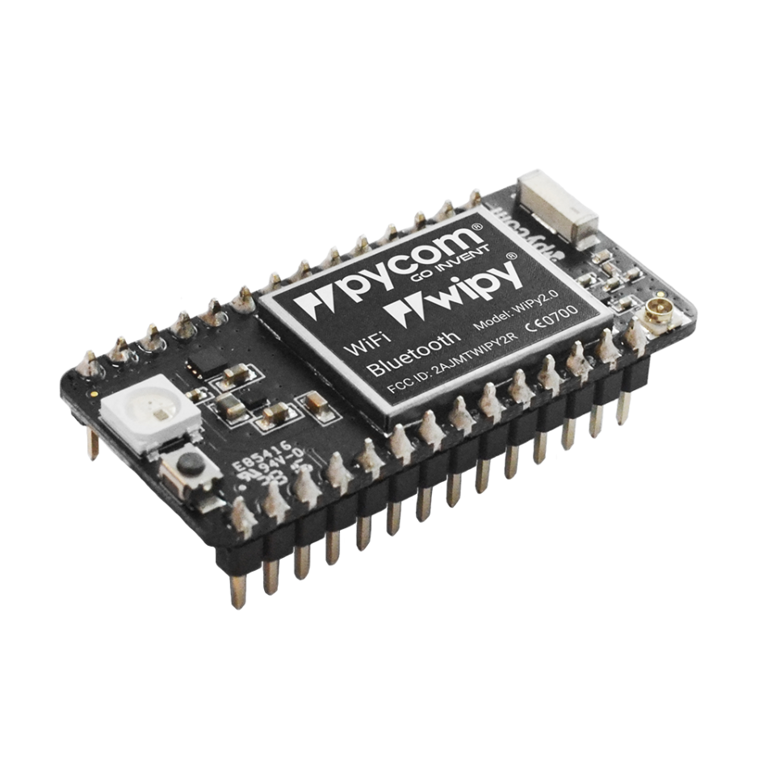
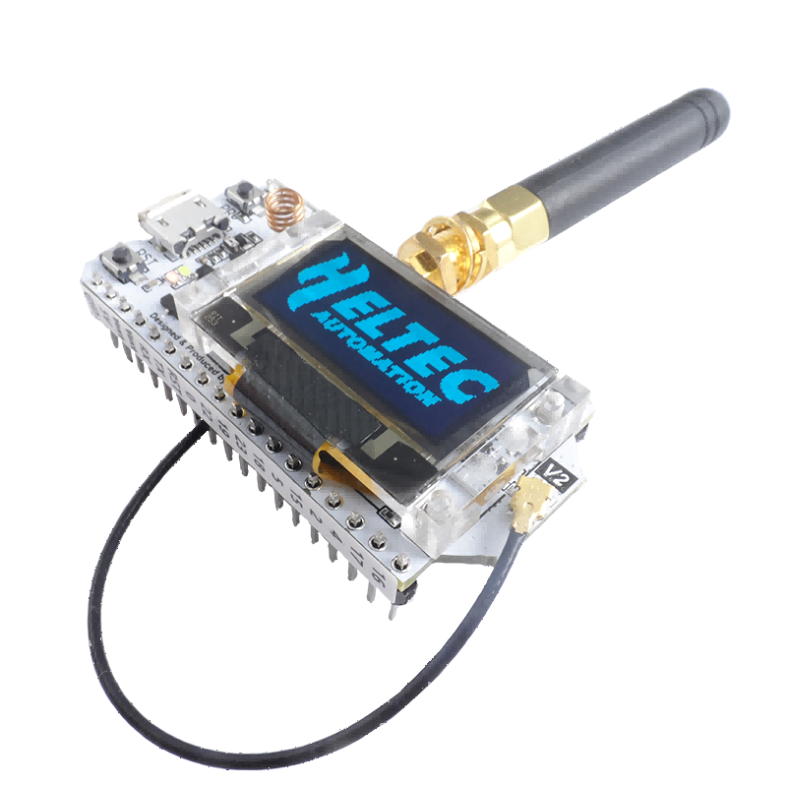
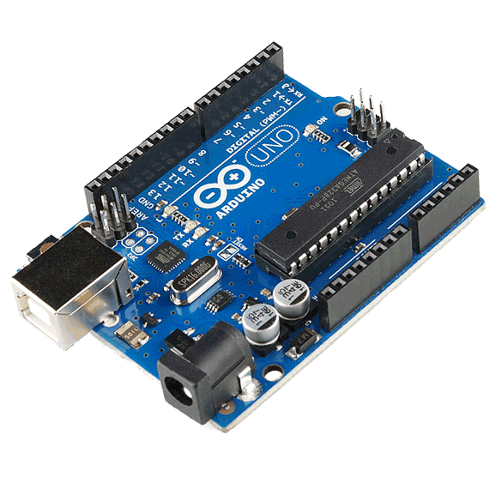
Author: Dom Wilkinson, M9WHQ
WHAT ARE MICROCONTROLLERS & MICROCOMPUTERS?
Microcontrollers
A microcontroller is a small computer on a single integrated circuit (IC) that contains a processor, memory
and programmable input/output (I/O) peripherals. They are used in embedded systems to perform a single,
specific task repeatedly.
Arduino UNO
ESP32
ESP32 With Embedded LoRa

Slide 4

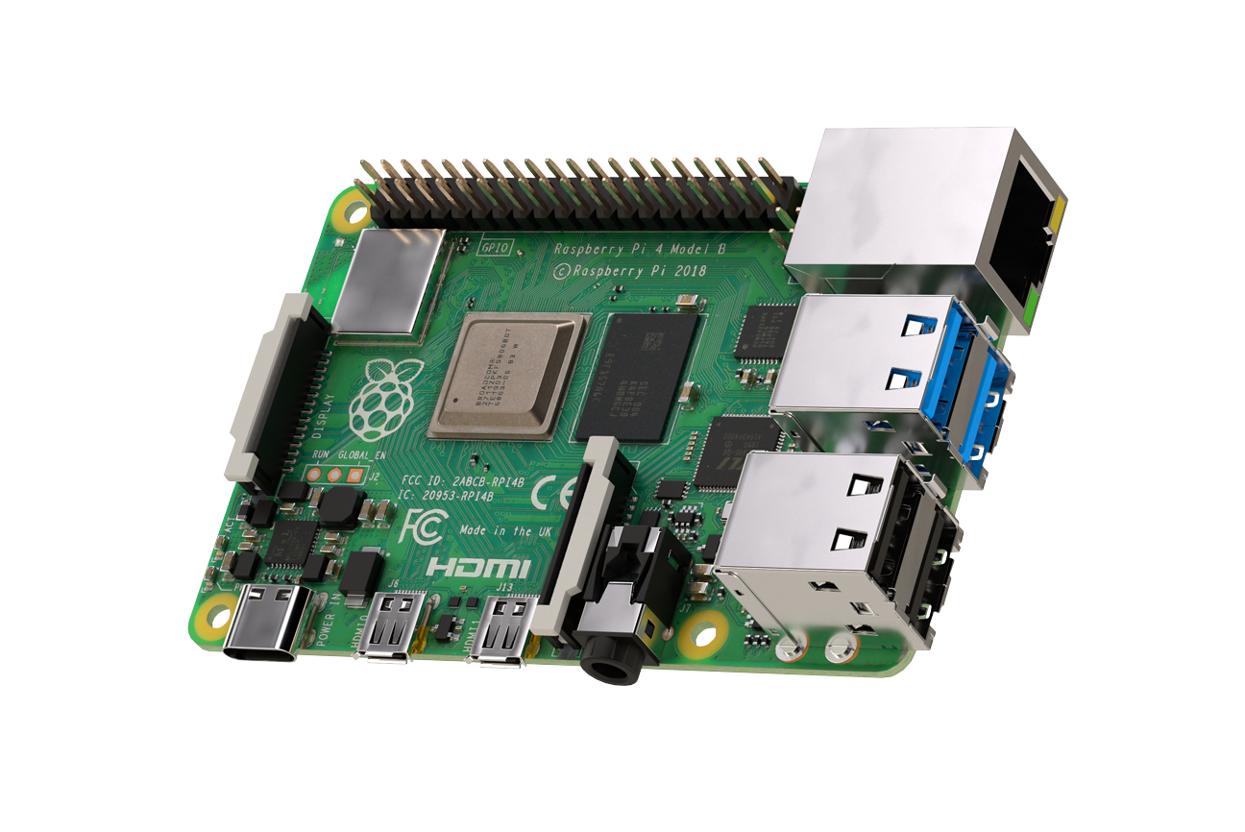
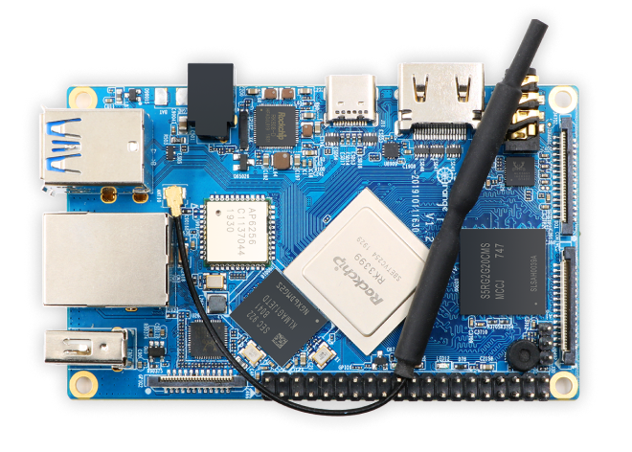
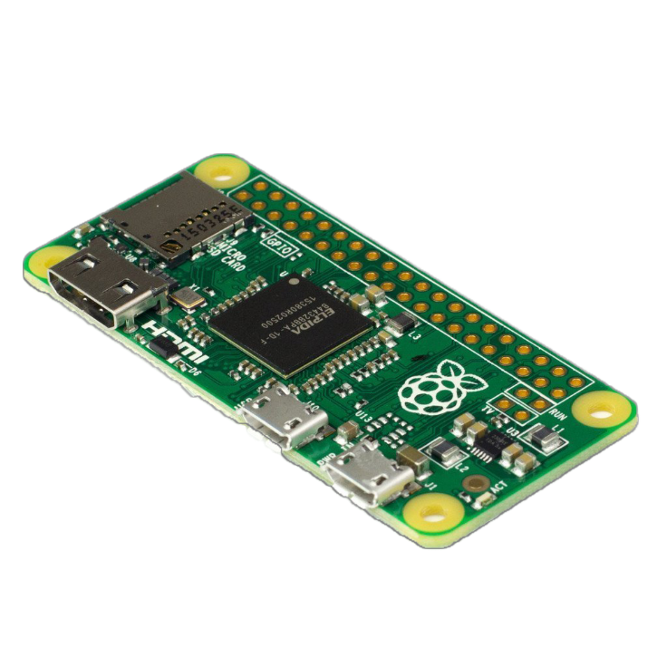
Author: Dom Wilkinson, M9WHQ
WHAT ARE MICROCONTROLLERS & MICROCOMPUTERS?
Microcomputer
A microcomputer simply used to mean a small computer, however as technology has advanced and more components
can be placed on a single board the term Single Board Computer (SBC) has become more common place. SBCs will
usually use a common UNIX (Linux) based Operating System (OS).
Raspberry Pi Zero 2W
Raspberry Pi 4
Orange Pi 4

Slide 5



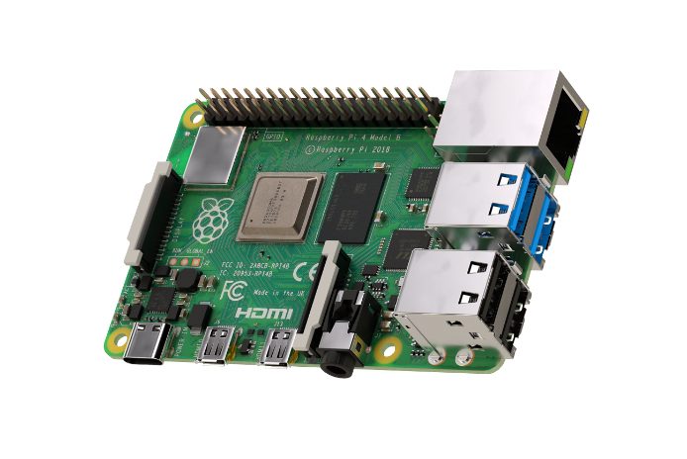
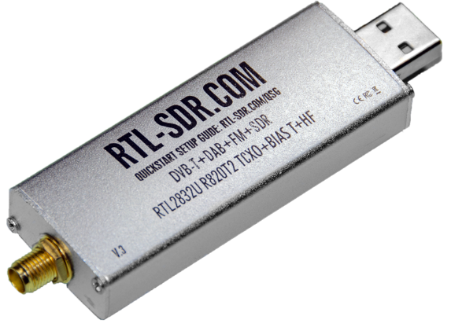
Author: Dom Wilkinson, M9WHQ
THE HARDWARE WE’LL BE USING
Heltec ESP32, LoRa 32, V3 Board. ESP32 with embedded LoRa. Comes in two
different frequency versions: 433-510Mhz, 863-928Mhz. Cost £15 - £20.
Raspberry Pi Zero 2W, or Raspberry Pi 4. Pi Zero 2W come with or without
GPIO header pins soldered. GPIO header not needed for these projects.
Pi 4 comes with different memory options 1GB, 2GB, 4GB, and 8GB. 1GB
is sufficient for these projects. Recommend using a Pi 4 if you can afford it.
Pi Zero 2W Cost £15 - £20. Pi 4 Cost £34 - £72 (depends on memory size).
DVB-T & DAB+FM or RTL SDR (Software Defined Radio) USB Dongle.
Come in various makes and models. Make sure you check the chipset being
used or the dongle specification. Chipset needs to be RTL2832U/R820T2,
FC0012 or must be capable of receiving up to 1200Mhz (1.2Ghz). Some
cheap versions stop at 900Mhz. Cost £10 - £40 depending on model.

Slide 6
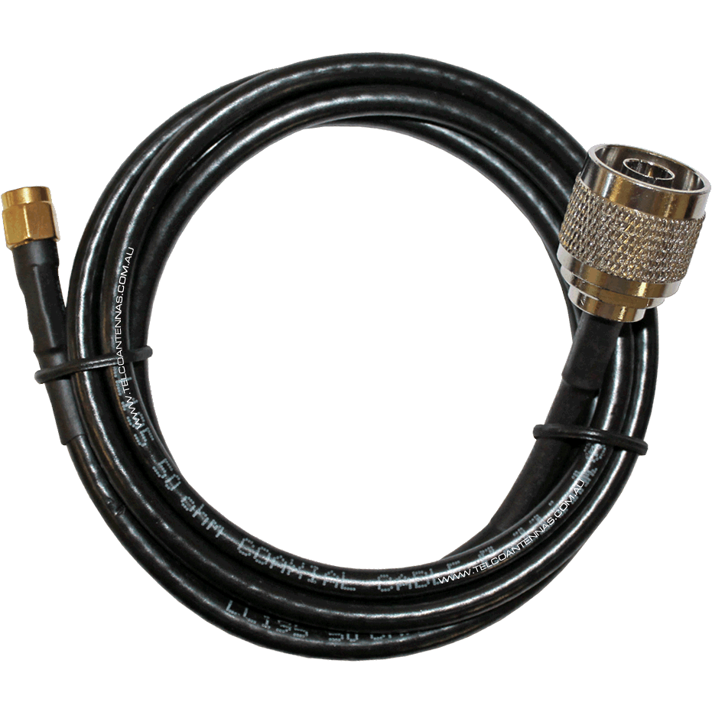
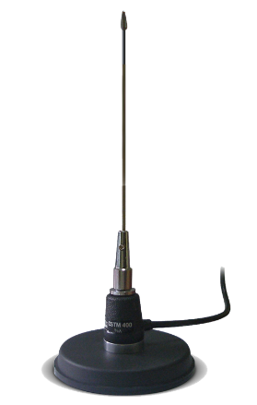
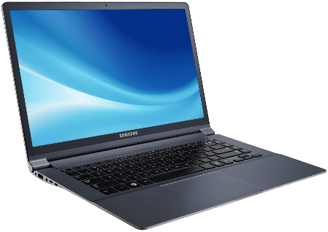
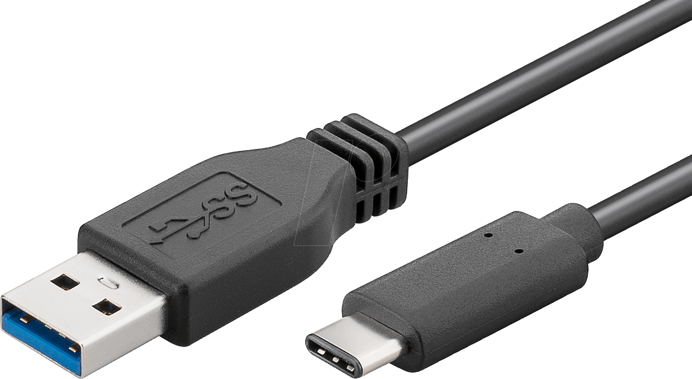
Author: Dom Wilkinson, M9WHQ
PROJECT 1 – TinyGS – Satellite Ground Station
Parts Required For Project 1
Laptop/Computer
USB C Cable
Heltec LoRa 32 V3
433-510Mhz Board
SMA RF Adapter Cable
Connector To Match Antenna
433Mhz Antenna
Any laptop or computer will do, as long as it’s connected to the Internet, has a browser and a USB port.
The USB cable is used to power and program the Heltec LoRa board. Once programmed, you use a 1A USB PSU to power the board. DO NOT USE A HIGH AMPERAGE PSU (2A Max.) OTHERWISE YOU WILL FRY THE HELTEC BOARD.
Connect an antenna to the Heltec LoRa board BEFORE you power it up. Treat these boards like a transceiver and
ALWAYS have an antenna attached. If it accidentally goes in to transmit with no antenna attached, then it can
overheat and will damage the board.
To get you up and running any resonant antenna will do. A 70cm antenna is absolutely fine for testing.

Slide 7

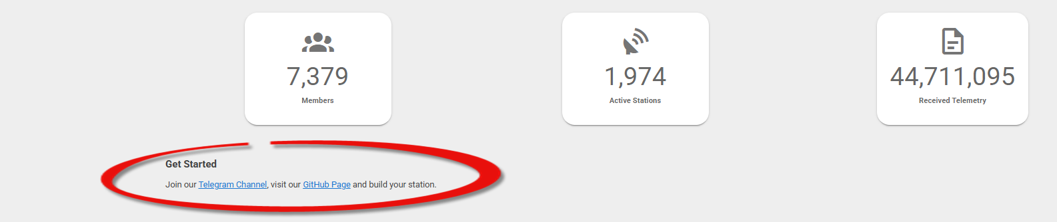
Author: Dom Wilkinson, 2E0WHQ
PROJECT 1 – TinyGS – Satellite Ground Station
WHAT IS TINYGS?
TinyGS is an open-source, community-driven project that builds a global network of low-cost ground stations for tracking
satellites and receiving data from them. It allows hobbyists, students and makers to build their own affordable satellite receiving
stations using open-source technology and readily available components to participate in satellite tracking and data reception.
https://tinygs.com/
https://t.me/joinchat/DmYSElZahiJGwHX6jCzB3Q - You need to join the Telegram Chat Channel.
https://github.com/G4lile0/tinyGS - This is the main software repository site and also contains all the documentation.
https://installer.tinygs.com/ - This is the web based software installer which will program the Heltec LoRa 32 board.
LIVE BUILD & DEMO

Slide 8



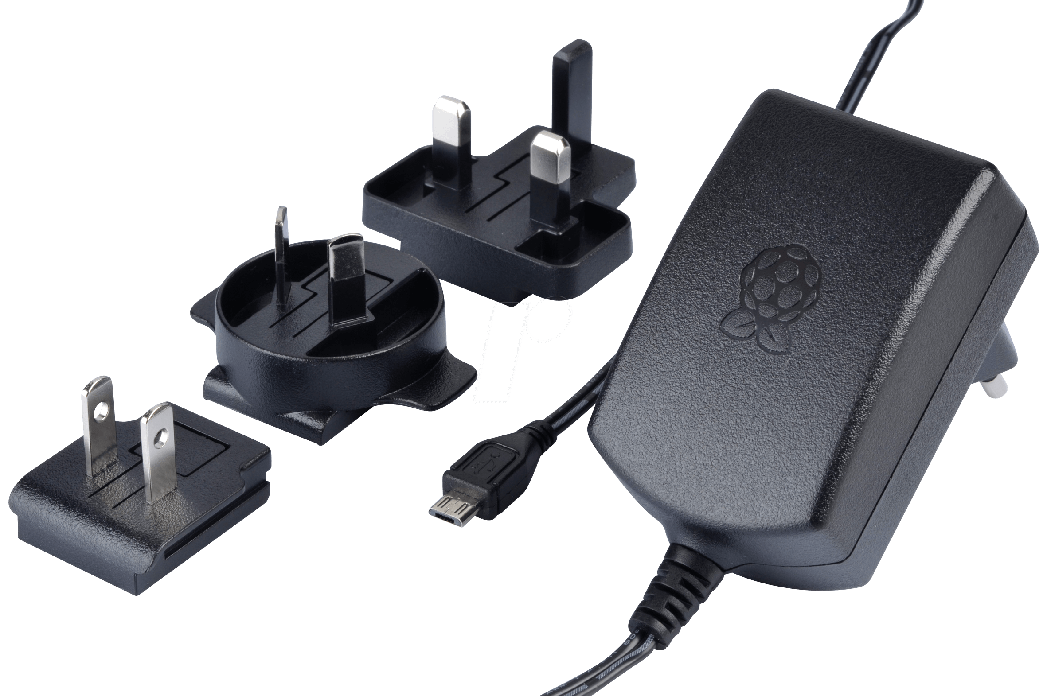
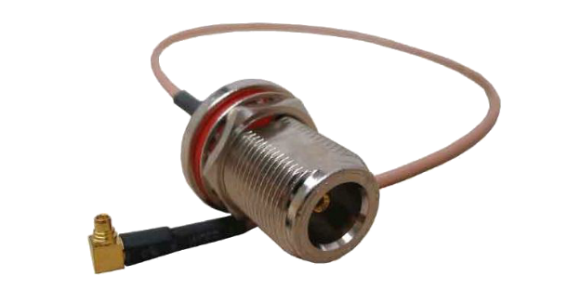
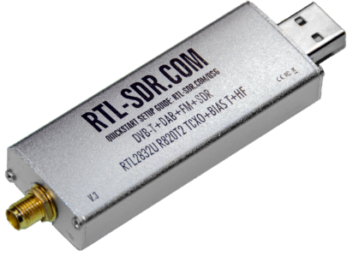

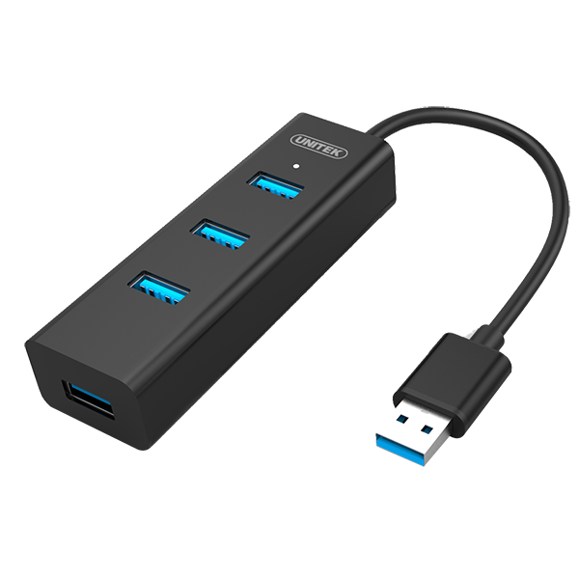
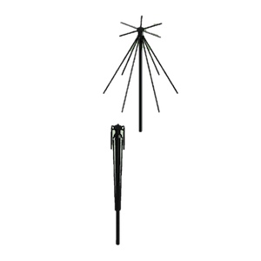
Author: Dom Wilkinson, M9WHQ
PROJECT 2 – THREE-IN-ONE ADS-B, ACARS & RADIOSONDE RECIEVER
Parts Required For Project 2
Laptop/Computer
Raspberry Pi Zero 2W or
Raspberry Pi 4
Good Quality
Raspberry Pi PSU
MMCX or SMA
Antenna Cable
3 x RTL SDR Dongle
(One per RX mode)
1 x Wideband Antenna or
3 x Antenna (One per RX)
USB Hub
(Optional)

Slide 9

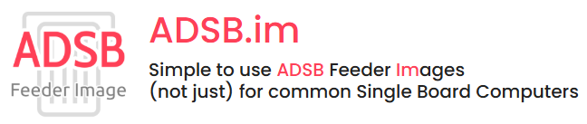
Author: Dom Wilkinson, M9WHQ
PROJECT 2 – THREE-IN-ONE ADS-B, ACARS & RADIOSONDE RECEIVER
WHAT IS ADS-B, ACARS & RADIOSONDE?
ADS-B stands for Automatic Dependent Surveillance–Broadcast, a surveillance technology that allows aircraft to automatically
broadcast their position, altitude, and velocity to air traffic control and other aircraft using a transponder transmitting on
1090MHz. Using these transmissions, we can track aircraft in real-time and feed out received data to global tracking websites.
ACARS, which stands for Aircraft Communications Addressing and Reporting System, is a digital data link system that allows
aircraft to send and receive short messages from ground stations. It is used by airlines to transmit and receive operational and
safety information, such as flight plans, weather updates, and engine performance data, improving both flight safety and efficiency.
The main VHF frequencies for ACARS in the UK and Europe are 131.725MHz, 131.525MHz and 131.825MHz.
RADIOSONDE is a battery-powered instrument package carried by a weather balloon that measures atmospheric data, such as
as temperature, pressure, and humidity, and transmits the information by radio to a ground station. In the UK Radiosonde
devices transmit on 401.000MHz to 406.000MHz with 100KHz channels.
For this project we’ll be using the excellent multifaceted ADSB.im Feeder Image Software which is capable of building ADS-B,
ACARS, Radiosonde and AIS (ship tracking) receivers.
https://adsb.im/home - Home of the ADSB.im project.
LIVE BUILD & DEMO

Slide 10

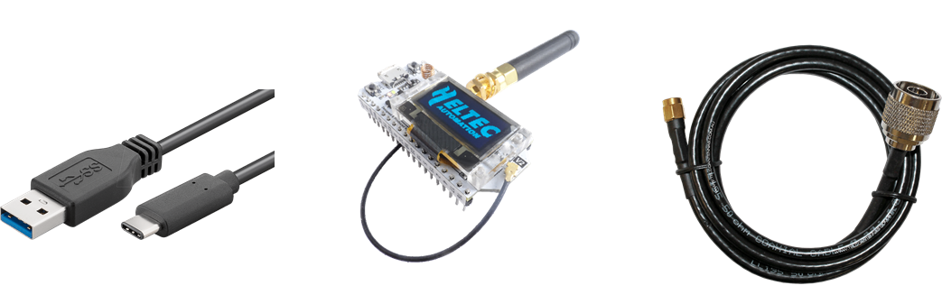
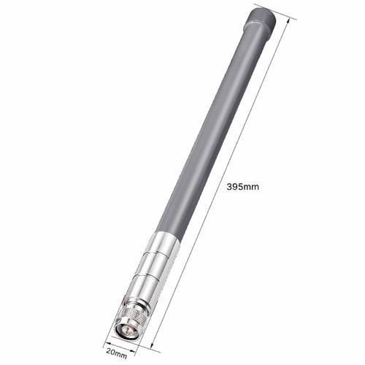


Author: Dom Wilkinson, M9WHQ
PROJECT 3 – MESHTASTIC ‘OFF GRID’ LoRa NODE
Parts Required For Project 3
USB C Cable
Heltec LoRa 32 V3
863-928Mhz Board
SMA RF Adapter Cable
Connector To Match Antenna
868Mhz Antenna
Any laptop or computer will do, as long as it’s connected to the Internet, has a browser and a USB port.
The USB cable is used to power and program the Heltec LoRa board. Once programmed, you use a 1A USB PSU to power the board. DO NOT USE A HIGH AMPERAGE PSU (2A Max.) OTHERWISE YOU WILL FRY THE HELTEC BOARD.
Connect an antenna to the Heltec LoRa board BEFORE you power it up. Treat these boards like a transceiver and
ALWAYS have an antenna attached. If it accidentally goes in to transmit with no antenna attached, then it can
overheat and will damage the board.
The Heltec board comes with either a ‘wire wound’ or ‘stubby’ SMA antenna. The ‘wire wound’ antenna is for handheld devices. You can also get a miniature 3.7V LiPo battery for handheld units.

Slide 11

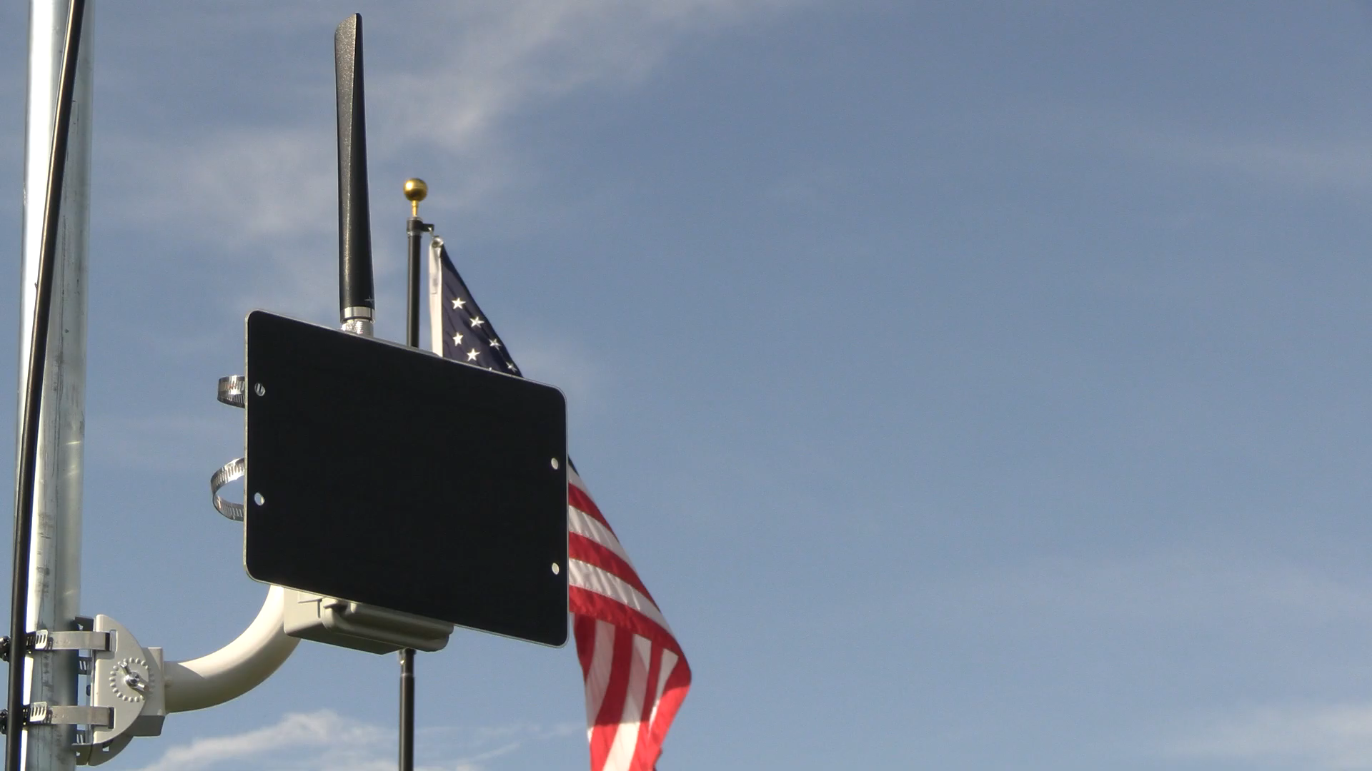
Author: Dom Wilkinson, M9WHQ
PROJECT 3 – MESHTASTIC ‘OFF GRID’ LoRa NODE
WHAT IS MESHTASTIC?

Slide 12
Author: Dom Wilkinson, M9WHQ
PROJECT 3 – MESHTASTIC ‘OFF GRID’ LoRa NODE
WHAT IS MESHTASTIC? – QUICK RECAP…
Operates on 868Mhz.
Licence Free.
Completely ‘Off Grid’ no dependency on Internet of GSM Mobile network.
With GPS attached it can be used for both tracking and messaging.
All nodes act as a message relay and form a mesh between themselves.
Cheap to setup and easy to operate.
The more nodes there are, the better the mesh will operate. Swindon’s mesh is growing almost daily.
Nodes mounted at height will improve the mesh coverage.
https://meshtastic.org/ - The main Meshtastic website.
https://flasher.meshtastic.org/ - Simple to use Internet based site used to ‘Flash’ your ESP32 LoRa Hardware.
LIVE BUILD & DEMO

Slide 13
Author: Dom Wilkinson, M9WHQ
THANK YOU FOR WATCHING
I HOPE THESE PROJECTS AND PRESENTATION WILL INSPIRE YOU TO TRY THEM YOURSELF
ANY QUESTIONS?

